Slide 1
in the name of GOD Data Plane Development Kit Software Optimization Guide
Rohullah Jahanafrooz
2023

Slide 2
Preface

Slide 3

History
2009 by Intel . Now open source software project (BSD License)
Kernel Bypass packet processing network technology

Slide 4
Arrival of multi-cores
Before that frequency was the key
NIC and RAM also got better, but frequency freeze
Multi-Core arrives but how to use it for data-plane processing ?
Dedicated cores to poll on the high-speed network port/queues
NIC driver run in kernel mode and by using interrupts
DPDK – Software based poll mode driver in user mode
Usages : network and security appliances, virtual switching for cloud, optimize storage systems with high IO demand, NFV,….

Slide 5
Cloud Era
In Cloud environment, we don’t have monolithic deployment. It is virtualization that each resource is shared among multiple consumers

Slide 6
Intel VT-d
CPU virtualization
Memory virtualization: DMA, remapping, EDT
I/O path: using multi core processors advantages. e.g. for nic: VMDQ (layer 2), SR/IOV (PCIe), DIDO
Graphic virtualization
NFV: DPDK, Quick Assistant, Hyperscan

Slide 7
What we coverage?
Multicore usage
Cache/memory management
Data synchronization
Scheduling
PMD (poll mode driver)
NIC-related off-load features
And so more …!

Slide 8
DPDK Foundation
Introduction
Cache And Memory
Core-Based Parallelism
Synchronization
Forwarding
PCIe/NIC
NIC-Based Parallelism
NIC offload
Packet Security

Slide 9
What is packet processing?
reception and transmission, header parsing, modification, forwarding.
Silicon used for packet processing system:
Hardware Accelerator (FPGA, ASIC)
Network Processing Unit (NPU)
Multi-core Intel X86 CPU
In Multi-core a few cores can be assigned to handle data-plane processing and others for control and service.

Slide 10
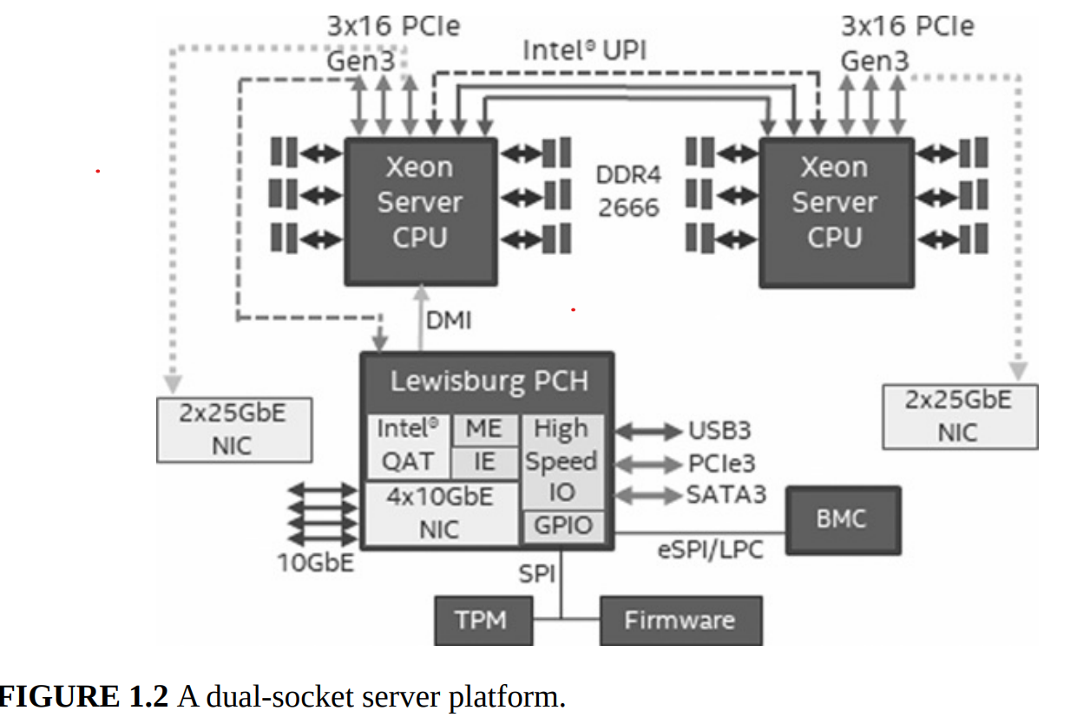
Dual-socket server platform

Slide 11
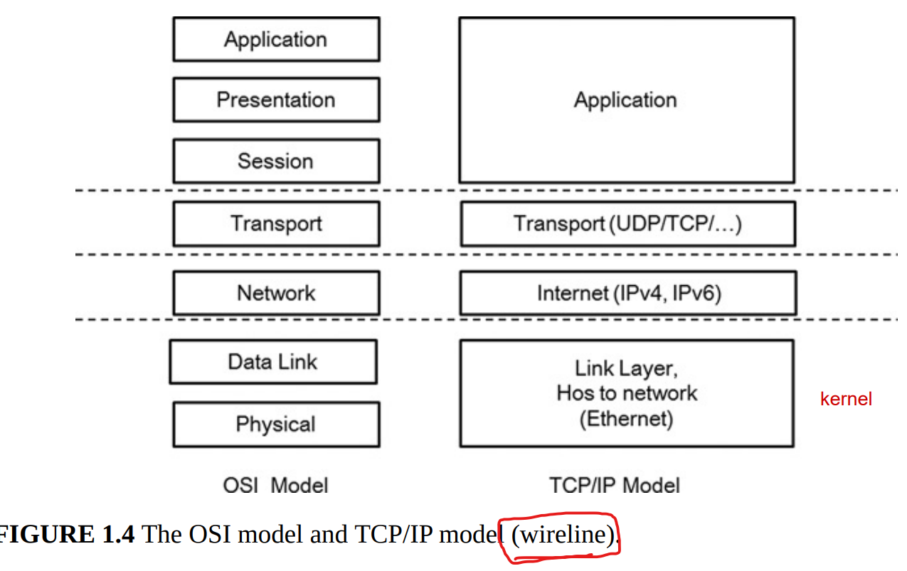
Before DPDK
Apps that resides in User space and NIC drivers that are in kernel space

Slide 12
Before DPDK
NIC interrupt: Packet arrives in NIC (PCIe device)
The NIC completes the DMA and copies the packet into host memory region (packet buffer)
Software interrupt: NIC sends an interrupt to wake up the processor
The processor reads and writes the packet descriptor and packet buffer
The packet is sent to Linux kernel protocol stack layer for more protocol processing like IP-related access control decision
If the application resides in user space, the packet data (payload) will be copied from kernel space to user space. But if the application resides in kernel space, the data will be processed in kernel mode.

Slide 13
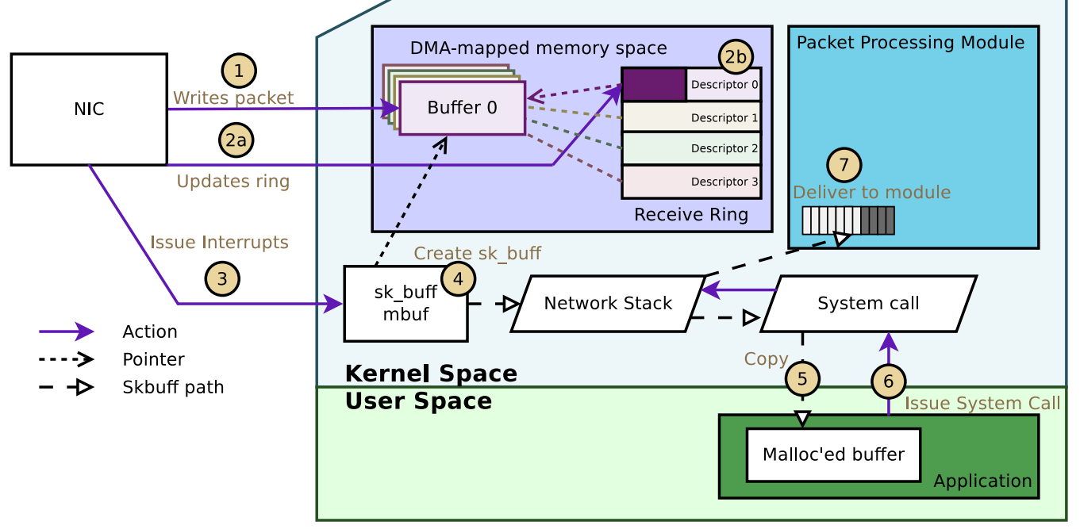
Linux TCP-IP Stack

Slide 14
Before DPDK
Problem ?
Solutions :
NAPI : after CPU wakeup, initiate the software routine that process multiple packets in a polling manner, until all packets are handled goes back to the interrupt mode
NETMAP (2011): an network IO framework that uses a shared pool of packets to reduce the packet replication from kernel space to the user-space
But there are areas still for improvement : The additional overhead from task switch (scheduler) and the subsequent cache replacement
With the multi-core CPU there was a motivation to set dedicated cores for tasks

Slide 15
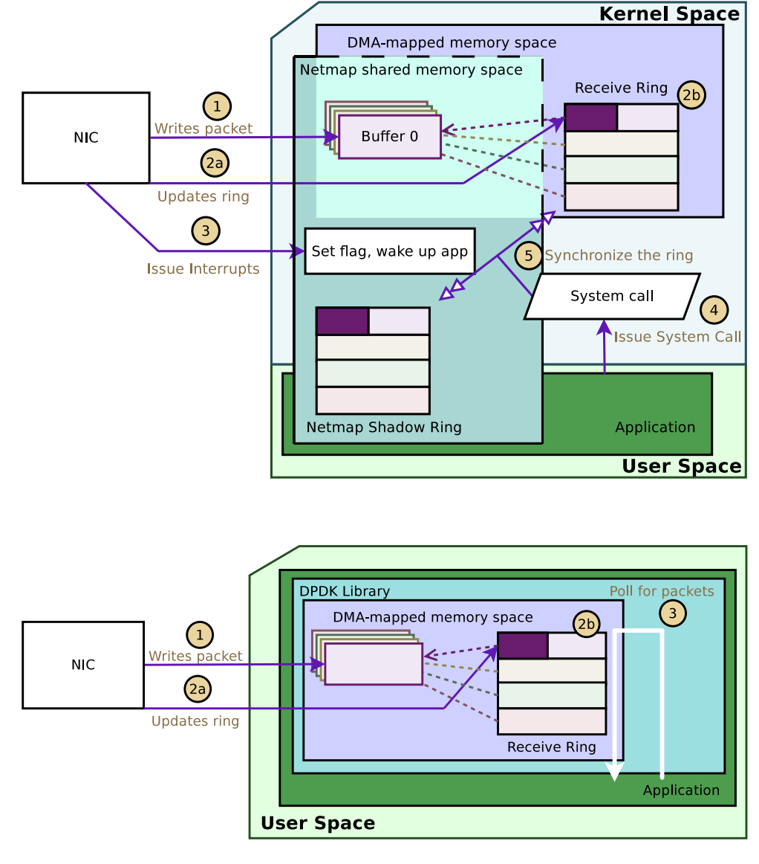
NetMAP.vs.DPDK

Slide 16
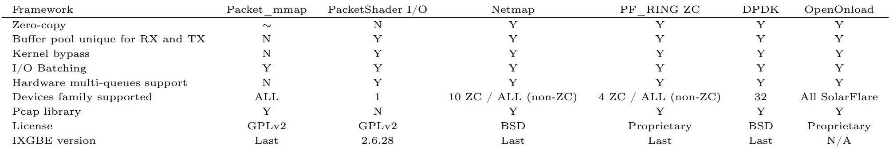
Frameworks Summary

Slide 17
DPDK ideas in brief
Polling Mode : dedicated cores for only NIC packet reception not for any other software tasks. So it removes interrupt but DPDK is also can be hybrid
User-Space driver : The application is usually in user-space and NIC driver is usually in kernel space. So it prevents the unnecessary memory copy. User-Space driver will also use DPDK-based mbuf (memory buffer) header format that is also more flexible instead of kernel ring structure
Core Affinity : bond specific tasks(threads) with cores
Optimized memory: both CPU and NIC need access to data shared in memory(cache and DRAM). using Huge page ( reduces TLB misses) and contiguous memory regions and multi-channel memory
Software tunning: avoid false sharing, cache alignment, prefetching

Slide 18
DPDK ideas in brief
Using latest instruction set and platform technologies: Intel DIDO that the packet data can be directly placed into cache.
NIC driver tunning : Receive Side Scaling (RSS)
Network virtualization and cloud-native acceleration: first DPDK was optimized for moving packets from IO to CPU, later DPDK provides the way to move packets from host to tenants(VM, container tenants) which is crucial for cloud infrastructure and NFVs.
Security Acceleration: Crypto and Compression APIs are important software abstraction independent of hardware

Slide 19
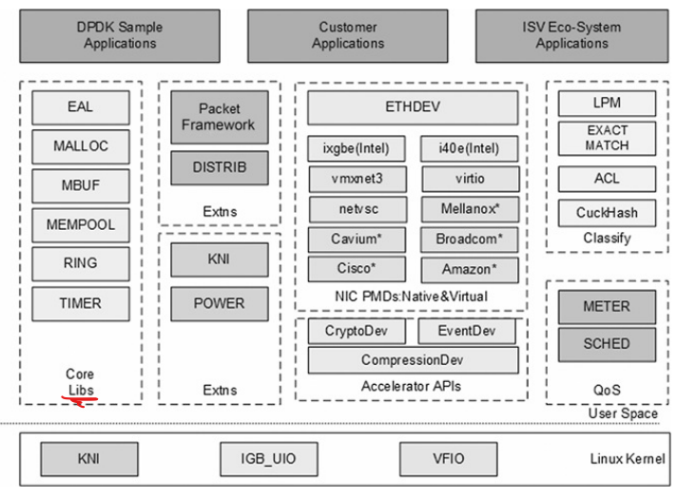
DPDK framework
Notes:
It is not all complete because new modules are added to DPDK evolving

Slide 20
Example Codes
Hello World
Skeleton
l3fwd

Slide 21
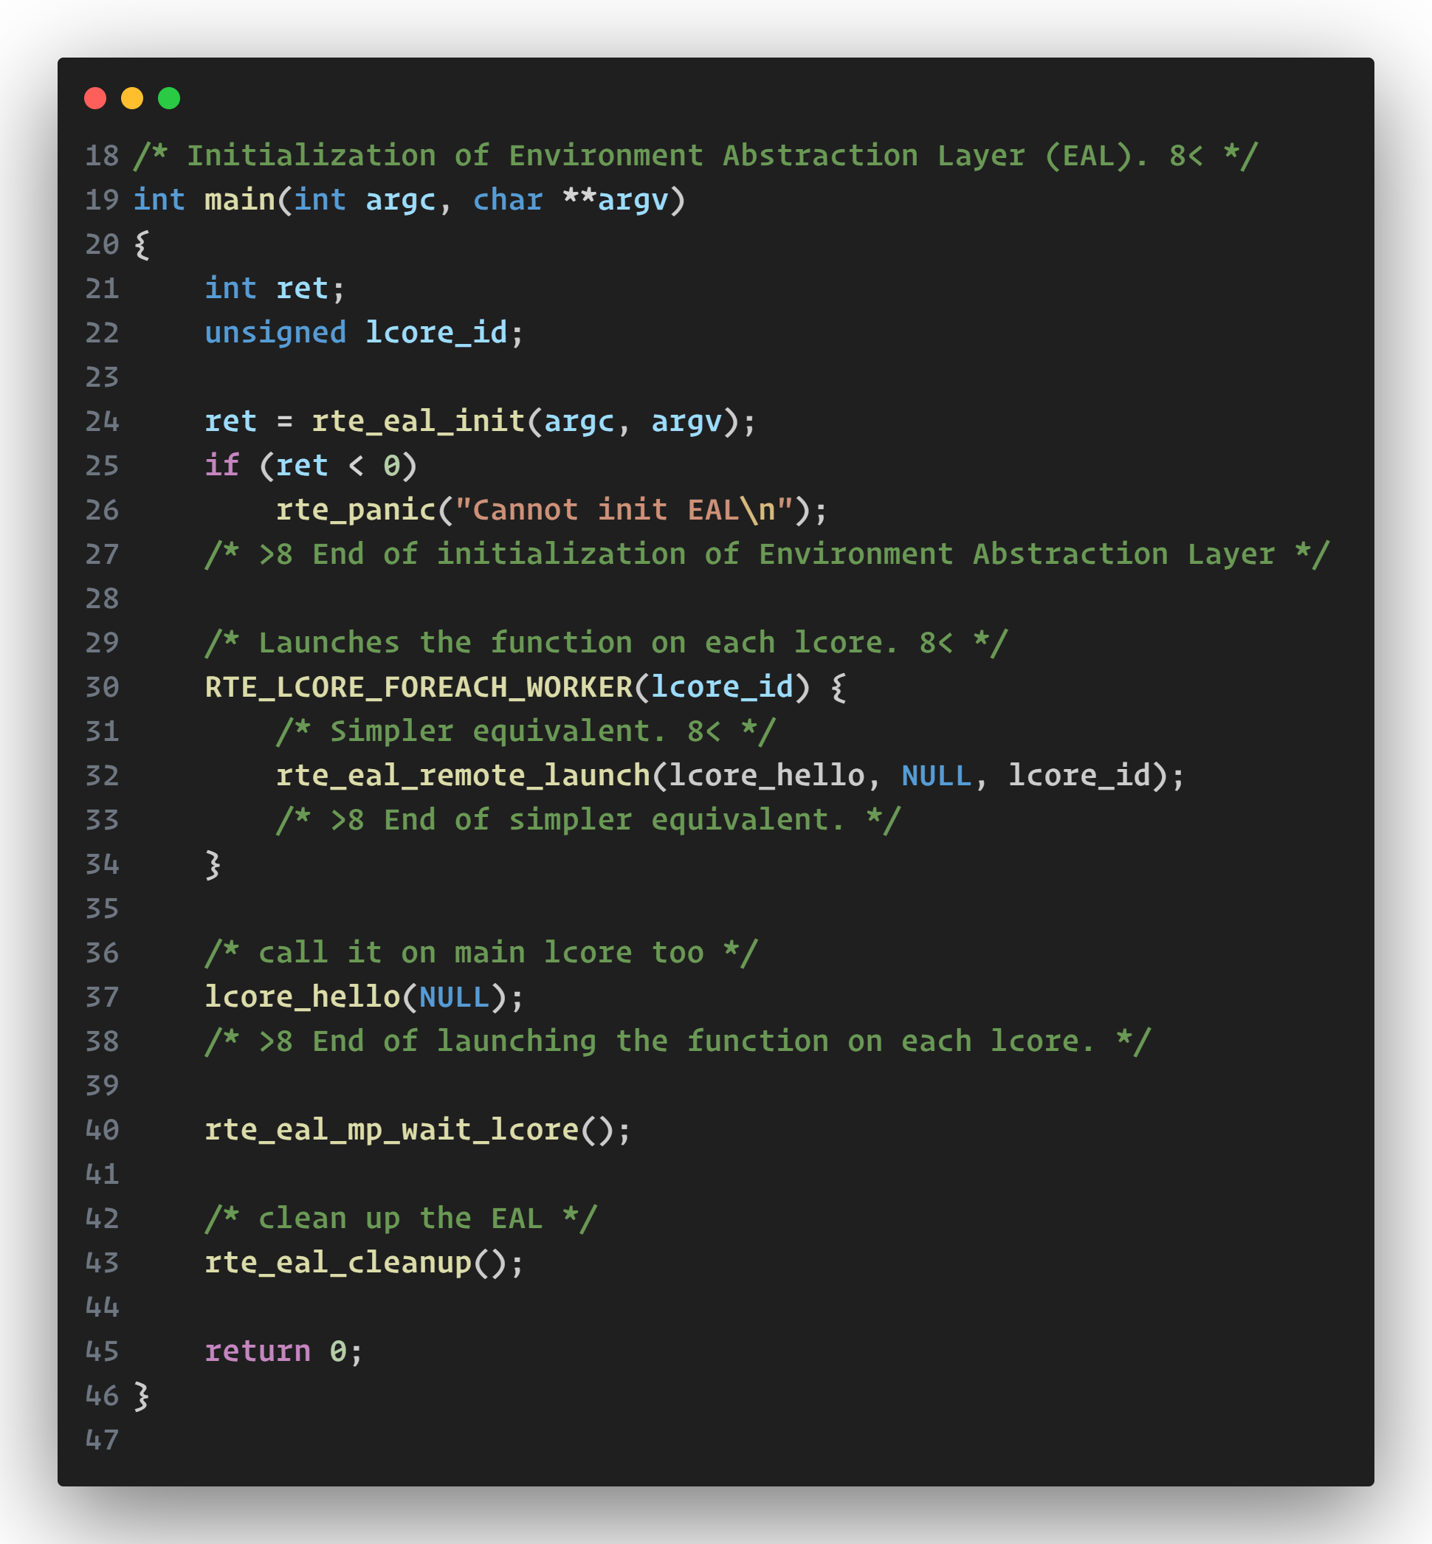
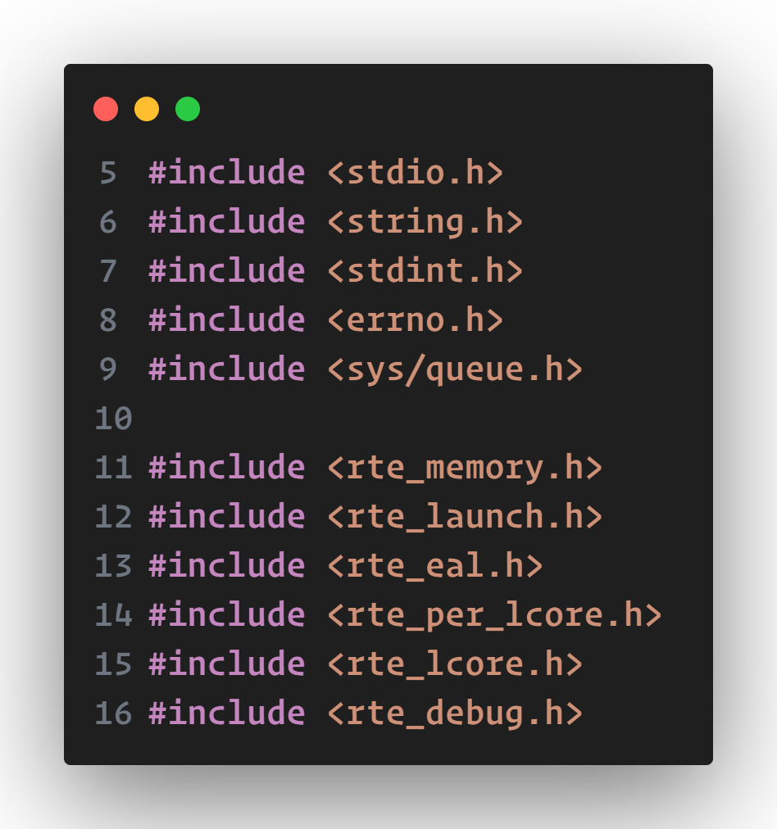
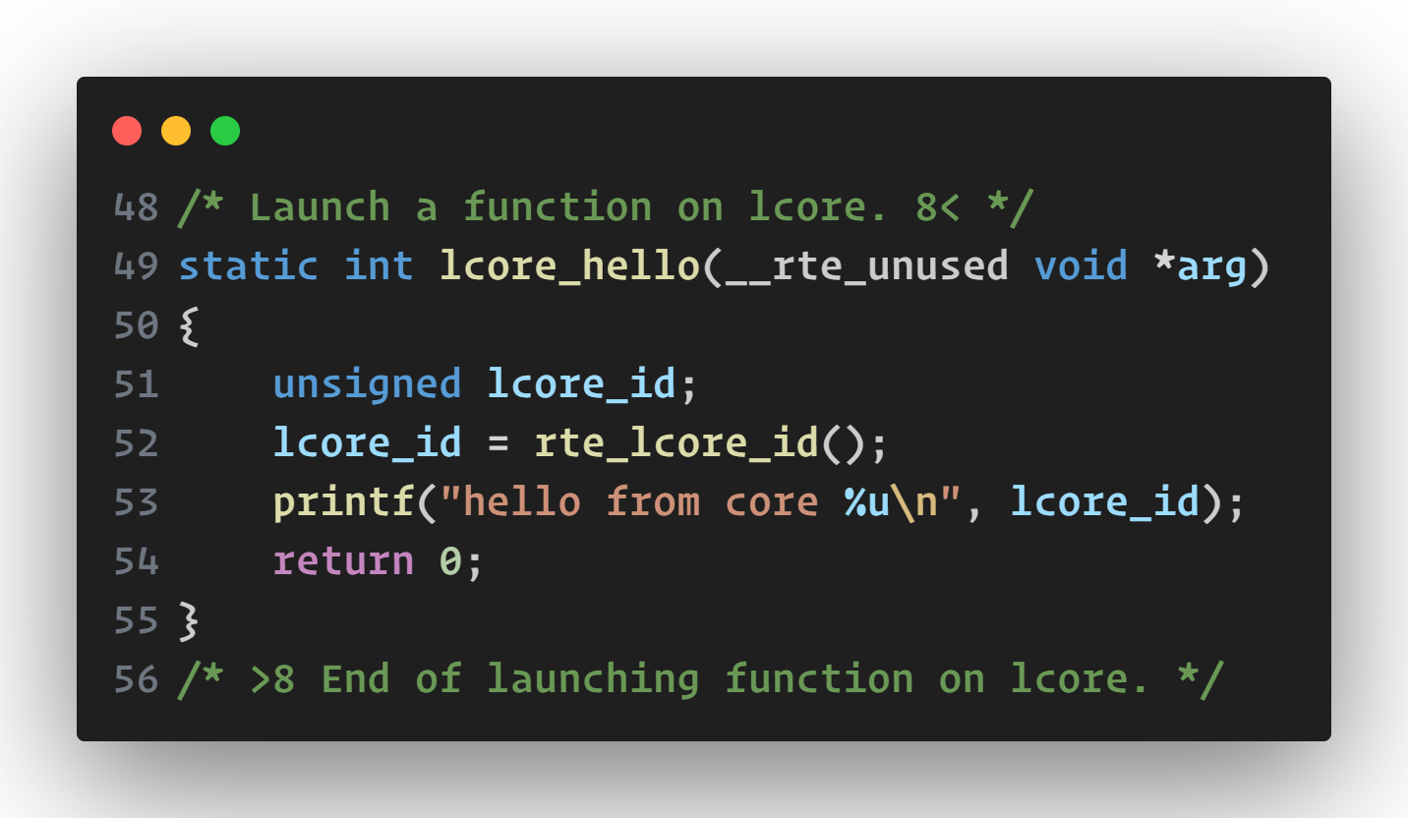
HelloWorld: Multithread Packet Processing Environment Setup

Slide 22
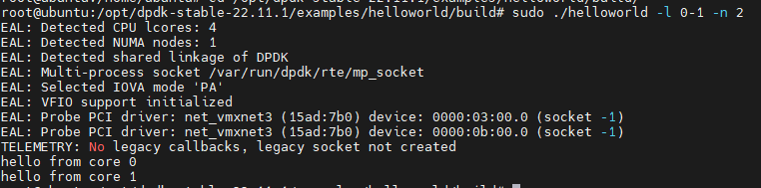
HelloWorld: Multithread Packet Processing Environment Setup
rte_eal_init(argc,argv): initializing config,mem poll,queue,PCI, master and slave threads….. (–C <core_mask>option) EAL environment
rte_lcore_foreach_worker(lcore_id): A macro to iterate all runnig lcores except MAIN designated by EAL. lcore_id is a specific core to run as slave thread
rte_eal_remote_launch(function,args,worker_id): designate thread on lcores
rte_eal_cleanup(): cleans up EAL(realease allocated internal resources)

Slide 23
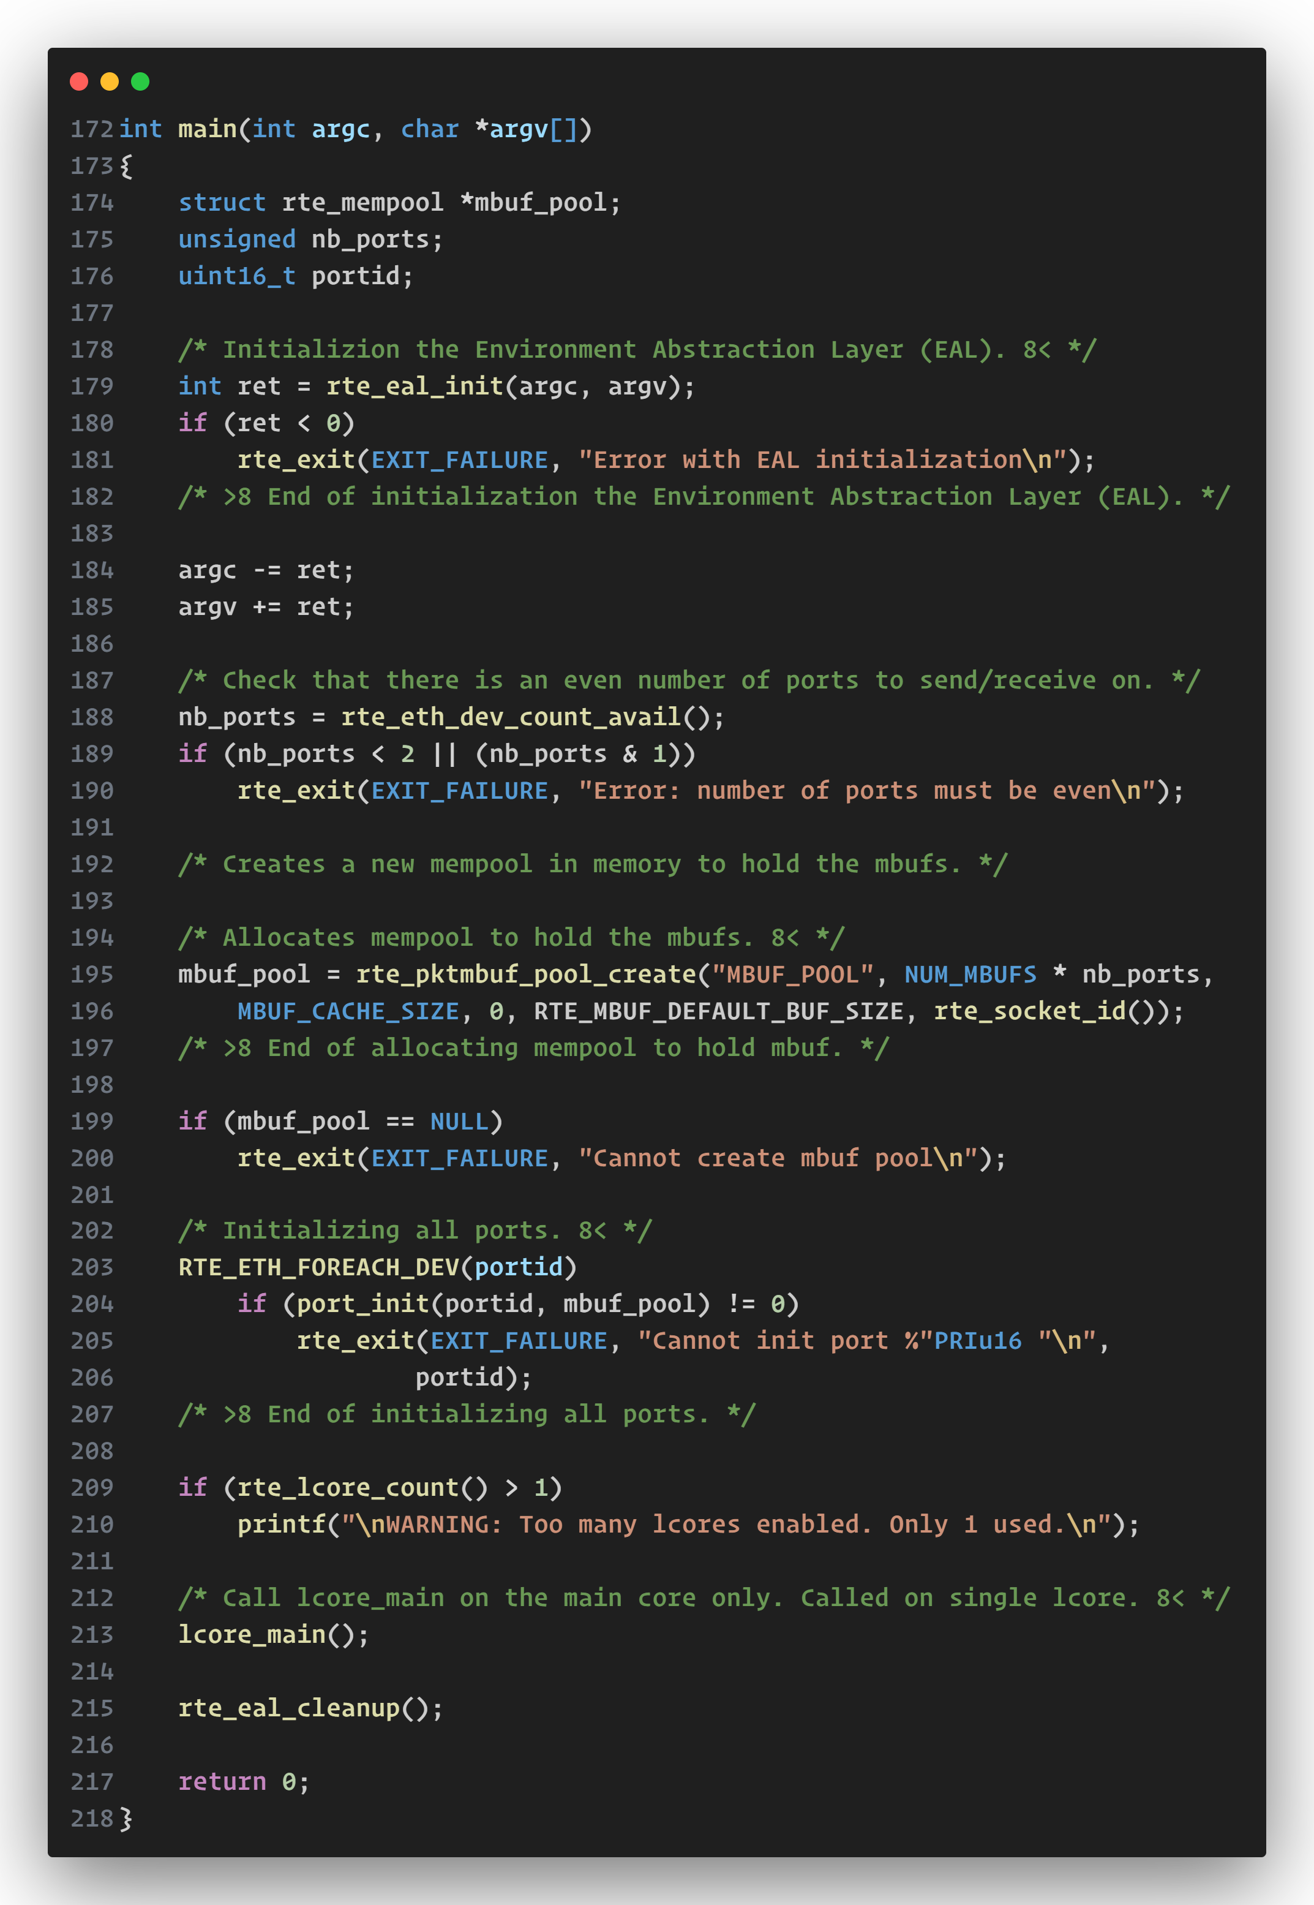
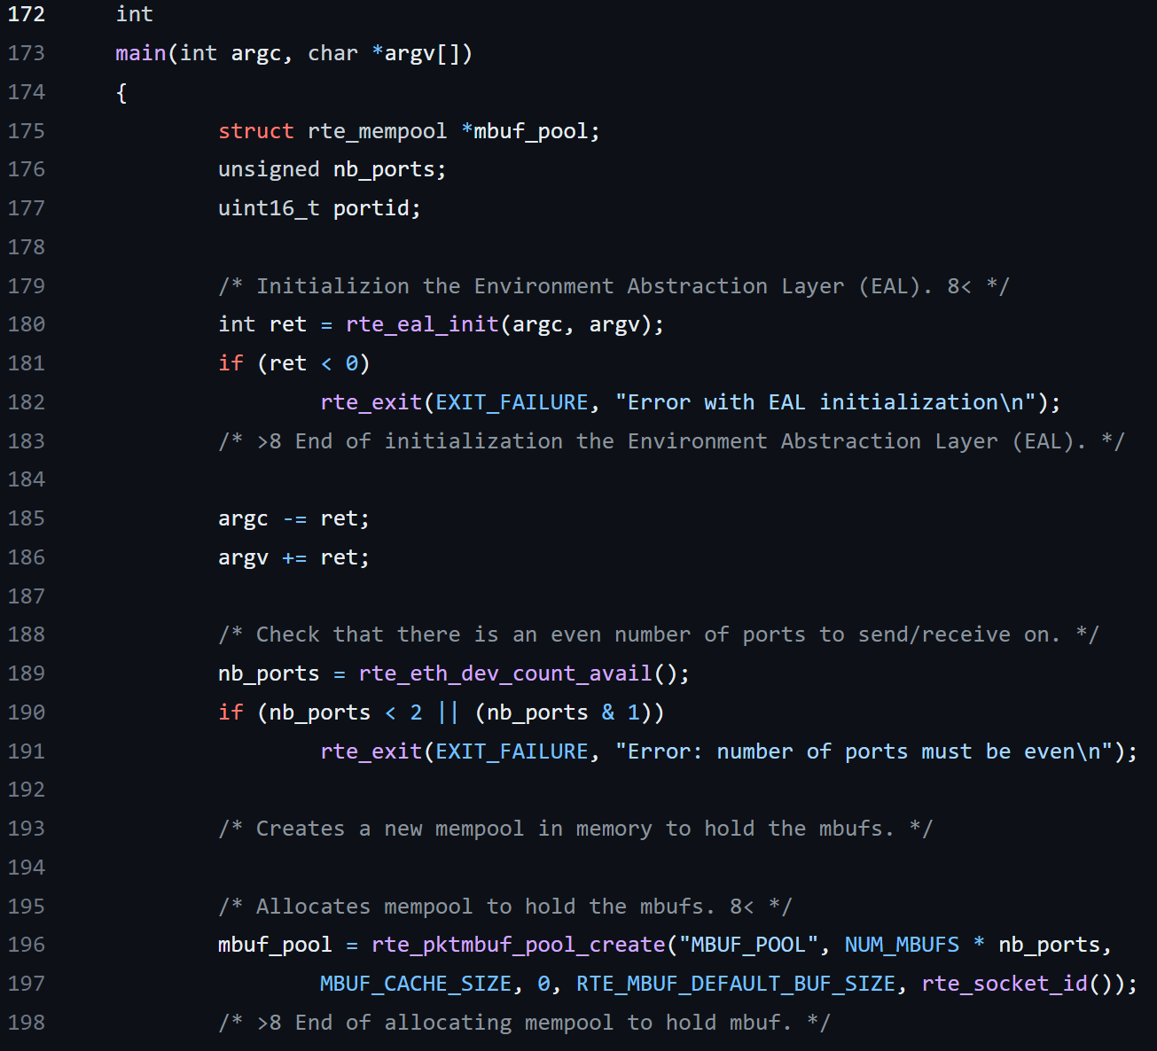
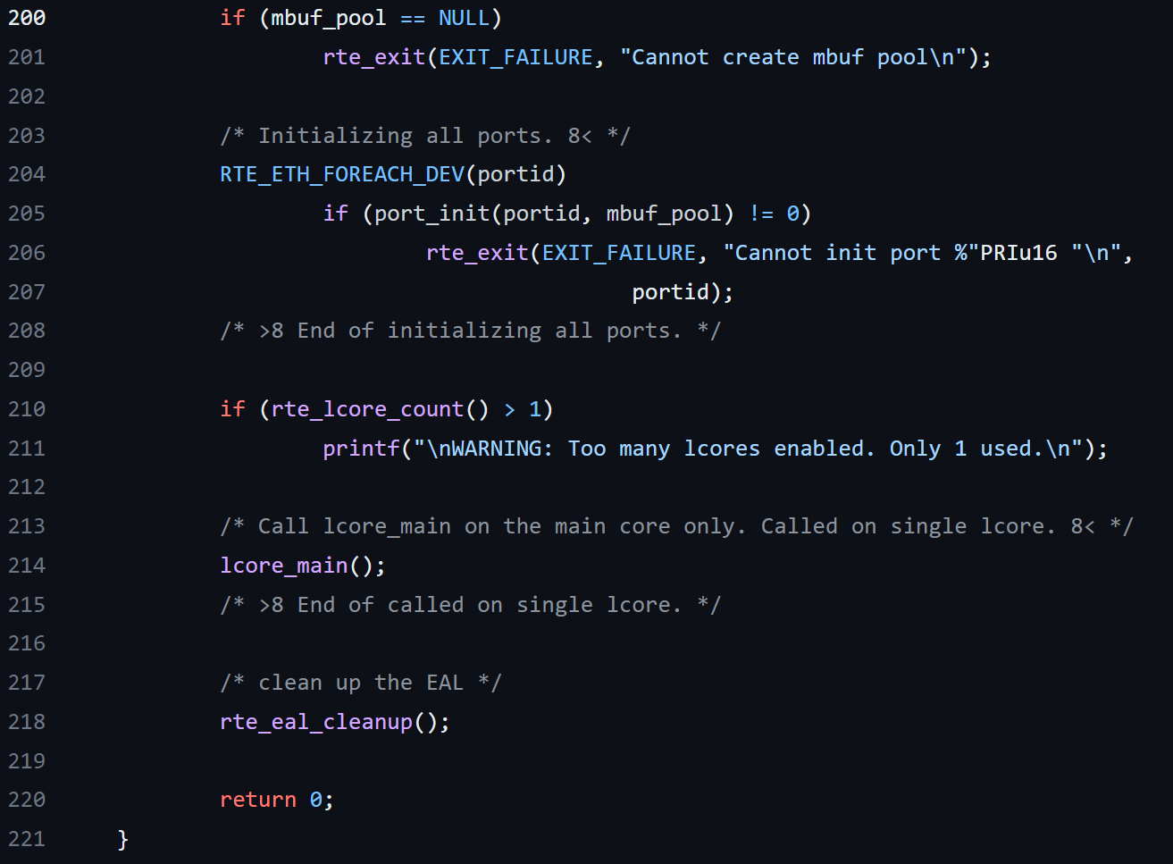
Skeleton: Simple One Thread Packet Receiver/Transmitter

Slide 24
Skeleton: mbuf pool
rte_pktmbuf_pool_create(name,n,cache_size,priv_size,data_room_size,socket_id): creates a mbuf pool in memory(always preferred to be local memory) to hold the mbuf
Each port can have multiple queues (receive or transmit) and also each queue can have its own buffer(DMA!) and the buffer is part of memory.

Slide 25
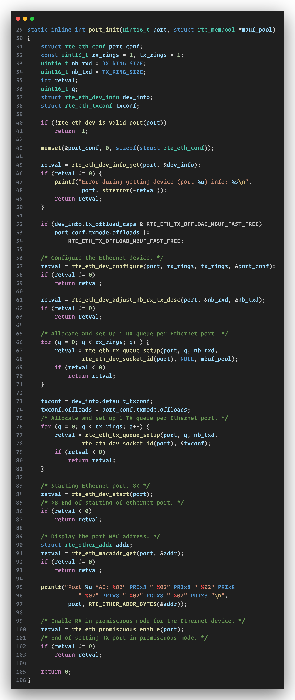
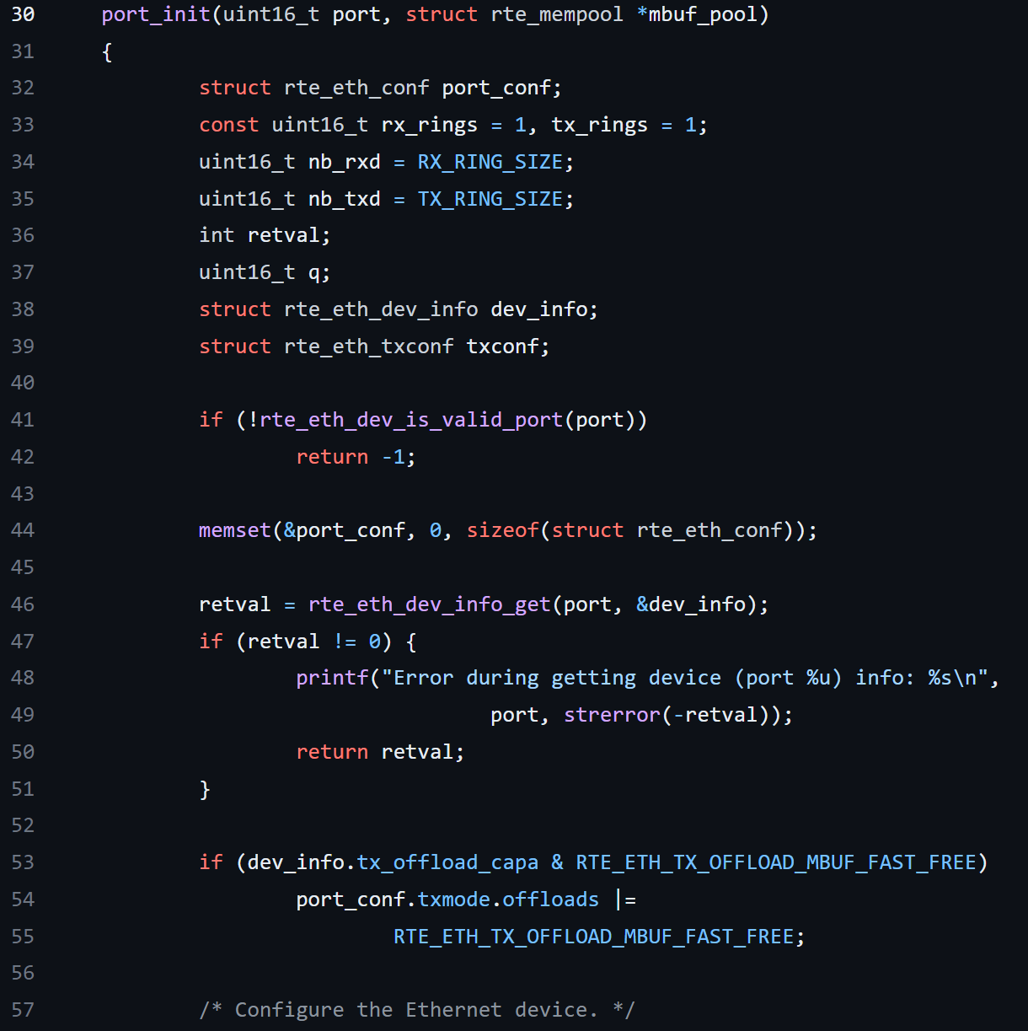
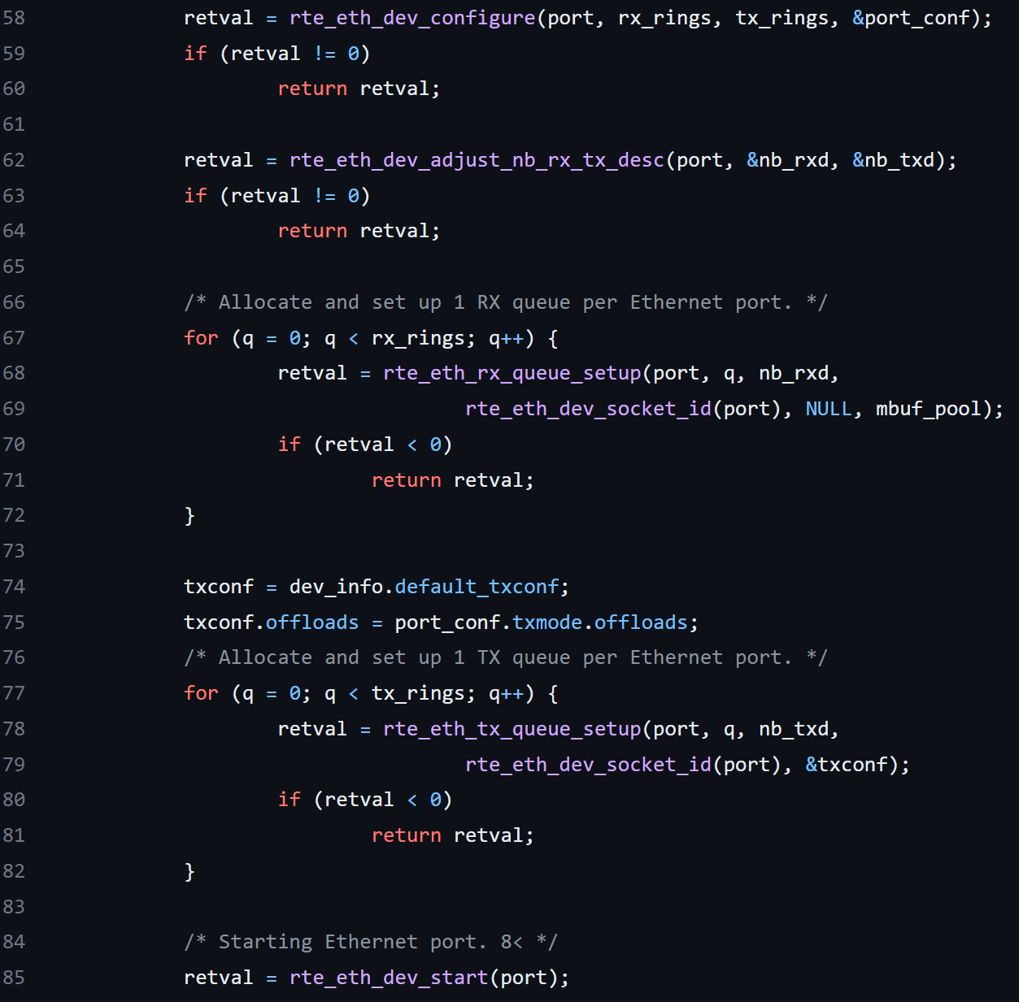
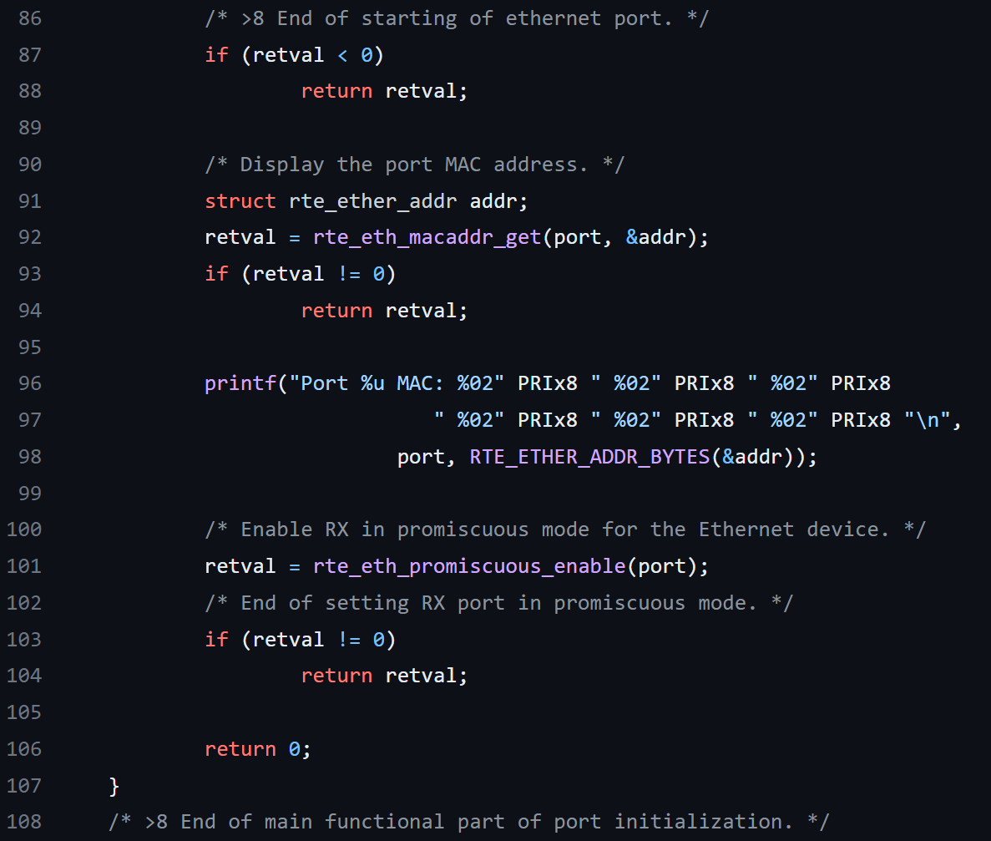
Skeleton

Slide 26
Skeleton: Ethernet Device API
rte_eth_dev_configure(port_id, nb_rx_queue, nb_tx_queue, eth_conf): should be called before any other function in Etherent API or when the device is in stopped mode
rte_eth_rx_queue_setup(port_id,rx_quue_id,nb_rx_desc,socket_id,rx_conf,mb_pool): Allocate and set up a receive queue for an Ethernet device.
rte_eth_tx_queue_setup(port_id,tx_quue_id,nb_tx_desc,socket_id,tx_conf): Allocate and set up a transmit queue for an Ethernet device
rte_eth_dev_start(port_id): The device start step is the last one and consists of setting the configured offload features and in starting the transmit and the receive units of the device. after Ethernet port initialization complete, we can start the device. And the port will be in Promiscuous mode. Upon finishing, Ethernet port can have the physical MAC address, and the port will be turned on with promiscuous mode.

Slide 27
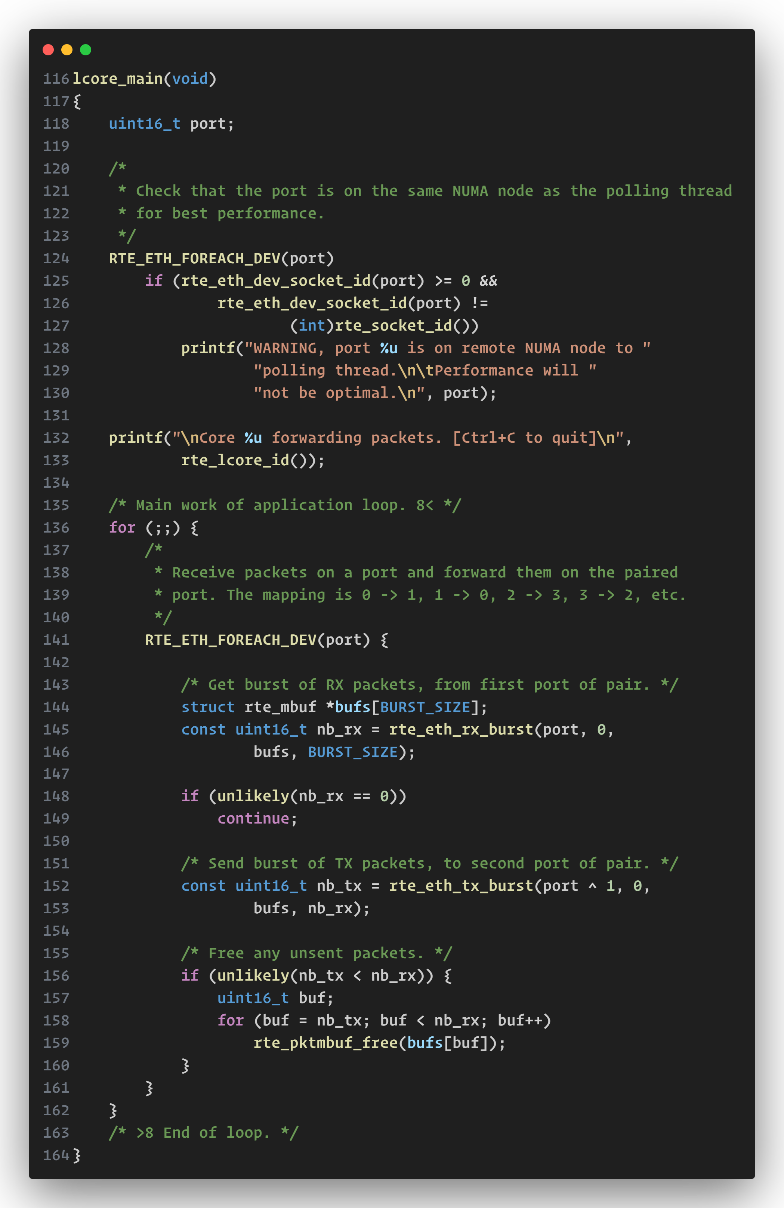
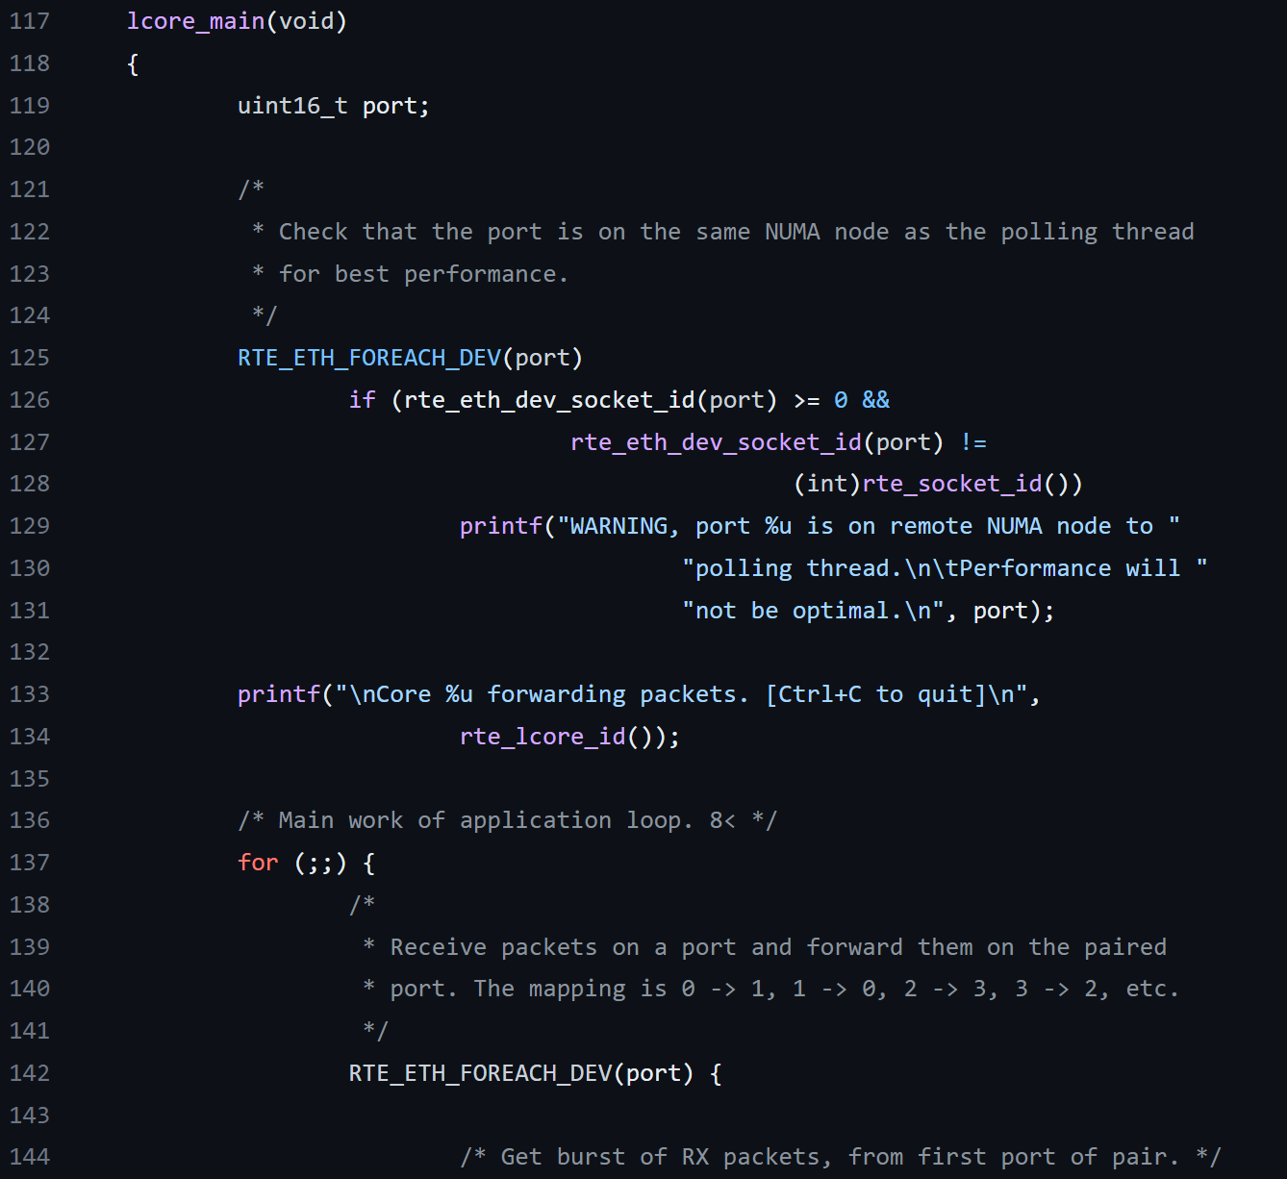
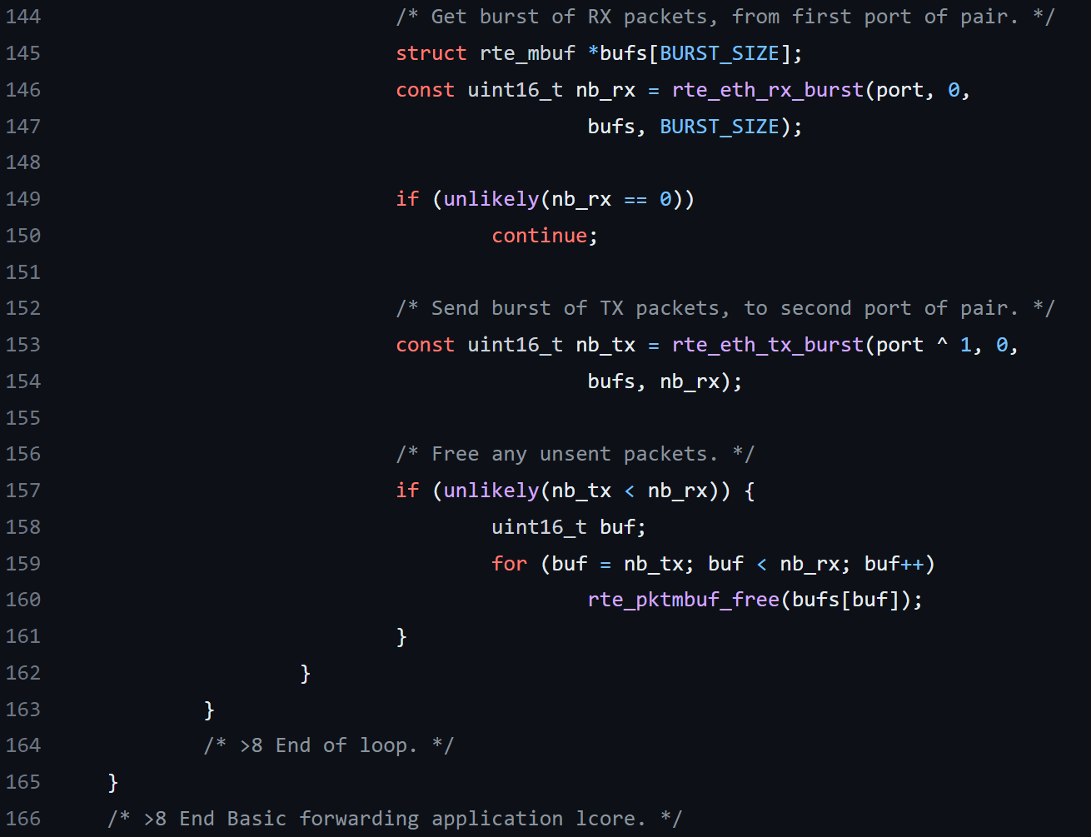
Skeleton

Slide 28
Skeleton: Ethernet Device API
Endless-loop packet reception and transmission
rte_eth_rx_burst(port_id,queue_id,rx_pkts,nb_pkts): retrieves a burst packets in a rte_mbuf
rte_eth_tx_burst(port_id,queue_id,rx_pkts,nb_pkts): sends a burst of packets

Slide 29
L3FWD: Measure DPDK preformance
CPU validates IP header and lookups routing table using destination IP and send packet through destination port with IP header modification like TTL update.
The routing Lookup Table could be
Exact Hash Match
LPM

Slide 30
Data Access Latency
Different memory chips has different access latency:
HDD
Memory (DRAM) usually DDR4
Cache (SRAM)
Registers
Cache is a mechanism between processor and memory to reduce latency
The compiler does not provide the suggestion on whether the code is written in a cache optimization way
What if the software wants to optimize his code (no need for them because compiler will be so intel)?
Notes:
INTEL launched Xenon Scalable Processor in 2017 which is designed for data-center workload

Slide 31
Cache Optimization Solutions ( HW and SW)
Cache line: that data will be in chunks of it (it is the min size of data block of for cache writing/reading) when fetched from memory before putting to L1/L2. the size of each instruction should be in a cache line
Data prefetch(speculative execution): no explicit function in C. It can be turn on for CPU in BIOS. And it will predicate the instructions it need and get from memory to cache. ➔ data locality(for loop), spatial locality: it depends on our code. But we need it for packet reading ( 6 steps) because the memory reading on NIC control structure and packet data buffer are not guaranteed by CPU-based prefetching.(DIDO is solution)

Slide 32
False Sharing
LLC(l3) cache is shared among all CPUs.
X86 is designed with a sophisticated mechanism to ensure cache coherency (accessing to an specific memory address simultaneously by multi cores).
This data sharing is not necessary because the multiple cores are not trying to access the same data (false sharing).If the optimizing option is enabled , the compiler can found false sharing
If false sharing is identified, the software fix is simple: Just ensure the shared data elements reside in a different cache line

Slide 33
Noisy Tenant
Noisy Tenant: cores competing for shared cache resource ➔ Intel RDT (cache monitoring)

Slide 34
Huge Page
Linux supports a file system hugetlbfs that can have HugeTables of 1GB. This feature should be enabled during kernel compile.
To reserve a memory for huge page:
At Linux boot time: use it as Linux launch option
At runtime
After reserving , mount the memory to hugetlbfs filesystem.
At system bootup, mmap() a system call, will map the reserved huge page to the virtual address space in userspace. Then Huge page can be used by DPDK in user-space and it can reduce the TLB misses penalty
Remember that different CPUs support different HP sizes.

Slide 35
Other Options for reducing Access latency
Intel Memory Latency checker to measure Memory Latency (remote or local memory)
Intel DIDO is available on Xeon since 2012 . Intel® DDIO enables the NIC and CPU to exchange data directly through the L3 cache, and NIC may move the packet into the LLC (instead of memory), as the new primary destination. In an optimized system, it reduces about 100 cycles for the arrived Ethernet packets
NUMA: if there was a local device (PCIe) on a NUMA node and with local cores on the node , we can use their local memory to process packet data.

Slide 36
Core-based Parallelism
1986-2000: frequency higher
Multi-core ➔ NFV, cloud
Using multicore the software should also be adopted
Amdahl's law: the speed up is limited by the serial part of program.
Multi-core Synchronous challenges ( will be covered later)
data collision in critical zone
fast execution in critical zone
…

Slide 37
Multi Core Terminology
Definitions :
CPU processor (node) : the number of sockets in server is the number of physical processors(CPU)
Physical/Process/CPU core : number of cores in each physical CPU
Logical core : every logical core has independent registers.
Hyper threading : reduces CPU idle states. when enabled, the software sees a physical core as 2 logical core(same coreID). When disabled, one physical core will be just one logical core.

Slide 38
Core Pinning
CPU affinity (CPU pinning) is a mechanism to improve performance for when a software thread is migrated from a core to another core to reduce overhead (l1,l2cache) by defining dedicated cores.
In DPDK we use this mechanism, so a core is often used with endless loop for packet processing(100% utilization!)
A thread in DPDK (EAL) is based on Linux’s pthread interface. DPDK creates so many threads and a DPDK thread can be either a main control thread(master) or many data-plane slave threads. Most of data-plane threads are either distributed or running in parallel, and each thread occupies a specifical logical core for packet processing

Slide 39
EAL pthreads to lcores assignment
Initialization:
rte_eal_cpu_init(): reads available CPU cores and builds the socket and core relationship
parse_args(): parses –c then assign cores and set the first core as Master
eal_thread_set_affinity(): create a thread for each slave core and call this function
Registration:
rte_eal_mp_remote_launch(): called by master core

Slide 40
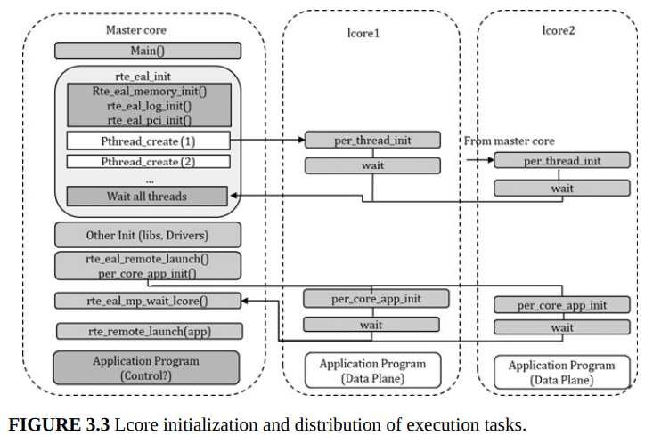
Lcore assignment in DPDK

Slide 41
Optimization Solutions for Software Programmers
Instruction Concurrency:
superscalar architecture allows to more than one instruction in a clock
Single Instruction Multiple Data:
improves performance by applying the instruction concurrency on the dimension of data width
It is some kind of vectorization operation. uses general purpose registers to hold wide data units.

Slide 42
Synchronization
Multicore challenge?
Synchronization of multiple cores when there is shared data among multiple cores
Solutions :
Memory Barrier (Memory fence): enforce the memory access in order. LFENCE,SFENCE,MFENCE
Atomic operation: Linux kernel provides two platform:
Atomic Integer Operation: ensures that the original order of instructions will be saved.
atomic_t data type
There is also atomic functions that are defined as Macro
Atomic Bit Operation:
Access to 1-word long memory region, 0-31 continued bits on a 32-bit machine or 0-63 continued bits on a 64-bit machine
DPDK had implemented its own Memory Barrier and Atomic interfaces
Memory Barrier API: They are implemented using FENCEs
rte_mb, rte_wmb, rte_rmb
Atomic API: check the source file for atomic data types and interfaces that are supported as 16, 32, 64 long.

Slide 43
RW (Reader Writer) Lock (another solution)
Parallel access to resource for read of other threads but exclusive for writing
busy_waiting mode
Accessing the shared resource:
Request the lock
Access the shared resource after the lock is acquired
Release the lock
RWlock requirements:
Mutex: A reader and a writer cannot access the shared resource (i.e., acquire the lock) simultaneously at any time.
Reader concurrency
No Deadlock

Slide 44
RWlock implementation
There are Linux API for both kernel and user space
DPDK API
Lock object is 32-bit integer
Lock interface is based on atomic operations using CMPXCHNGE
Caller block mechanism is implemented with PAUSE instruction within endless loop.
Read concurrently is based on an internal counter

Slide 45
SpinLock (another solution)
Similar to RWlock but the same mutex for reading
Busy waiting
The same implementation for user and kernel space API in Linux
DPDK implements the “recursive” spinlock. If a caller repeatedly requests the spinlock, it may run to the deadlock. The recursive lock can avoid this deadlock. The software will check if this is the same caller. If the caller has the lock already, it will increase the counter and the program can continue running

Slide 46
Lock Free
What is the problem with lock based safe memory protection ?
Data sharing
Wating cores
rte_ring: The packet sharing can be done via rte_ring among cores, and the mbuf buffer pointers are objects in rte_ring. And the enqueue/dequeue functions are indeed reading/writing rte_mbuf int rte_ring
Optimized memory use and cache alignment
Header and Tail Pointer for both producer and consumer
struct rte_ring* rte_ring_create (name, count, socket_id, flags)
This function uses memzone_reserve() to allocate memory
For the ring head update, the multiple producers or consumers can take advantage of atomic “compare and set” function

Slide 47
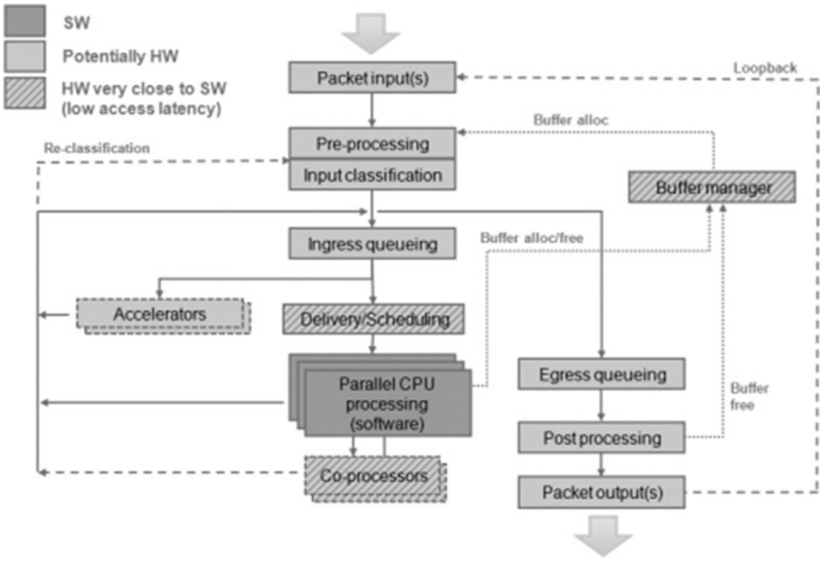
Packet Forwarding
Packet forwarding consists of steps that could be hardware based or software based
DPDK has built-in pipeline blocks like: ACL, LPM,…
Forwarding Models
Pipeline
RTC

Slide 48
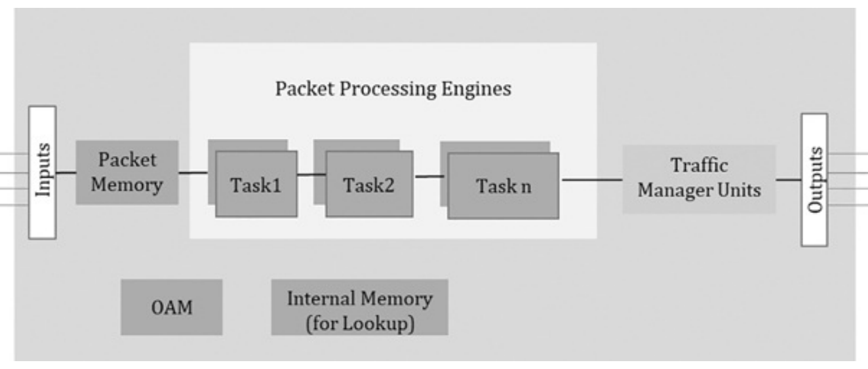
Pipeline
Divides a complex function into several individual stages
Data shared using queues between tasks
The system throughput is bounded by the slowest processing stage
The output from one task unit will become the input of the next task unit.
Hardware based pipeline:
each hardware execution unit is designed for a domain-specific task
Hardware resource. e.g. RAM

Slide 49
RTC
One execution engine and run the task until it is finished
RTC is heavily used in DPDK and software virtual switches
More services needed, just launch more instances
Doesn’t share data via queues among cores
Suits best for multicores and Software based forwarding
Overall latency may increased

Slide 50
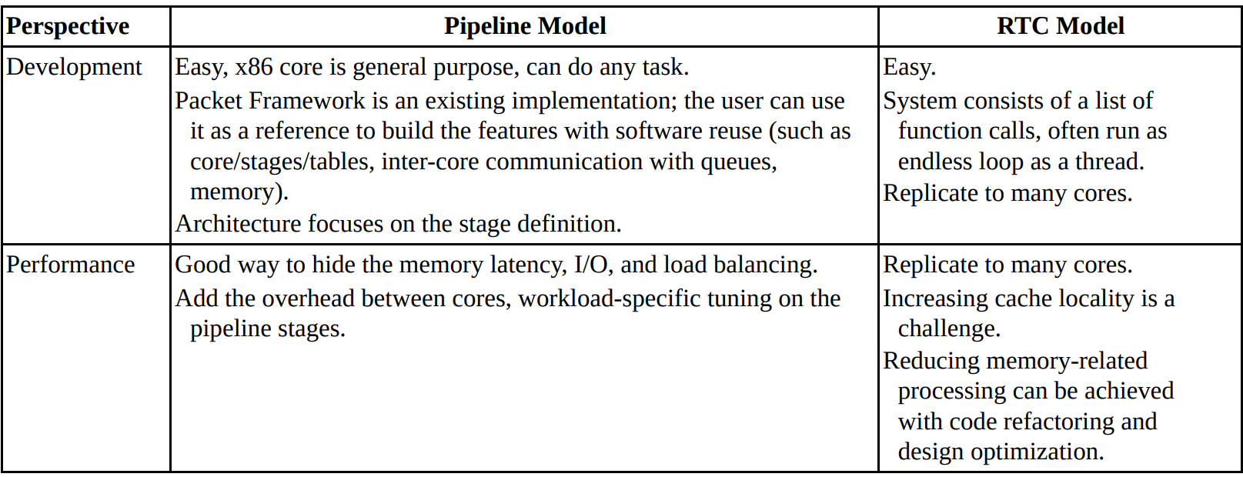
Hybrid Model
DPDK supports the pipeline model, the RTC models, and also the hybrid model
General purpose CPUs such as x86 can run any of the model flexibly
Today software based pipeline is dominant because of more flexibility than hardware
Which one to use?

Slide 51
DPDK specifics
RTC model: use multicores and NIC RSS
Pipeline: DPDK provides a framework named Packet Framework that is logically similar to OpenFlow that comprises a pipeline of match-action tables (port,table,pipeline,action,…)
librte_port
librte_table
librte_pipeline
We can define reusable template and extensible templates for pipeline modules using these libs and each module can consists of: input ports, tables, output ports.

Slide 52
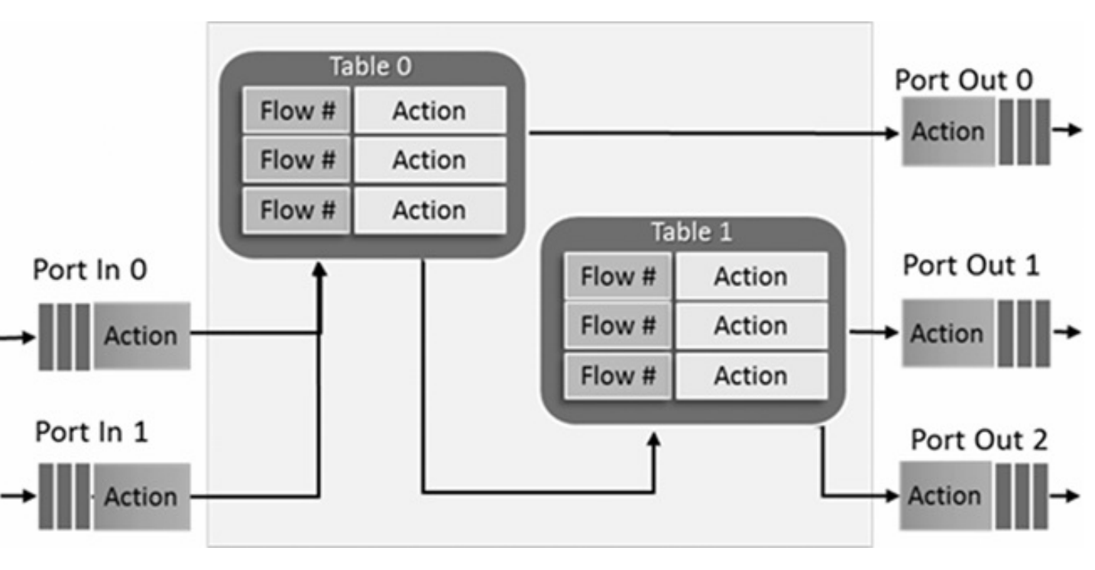
DPDK pipeline block (module)

Slide 53
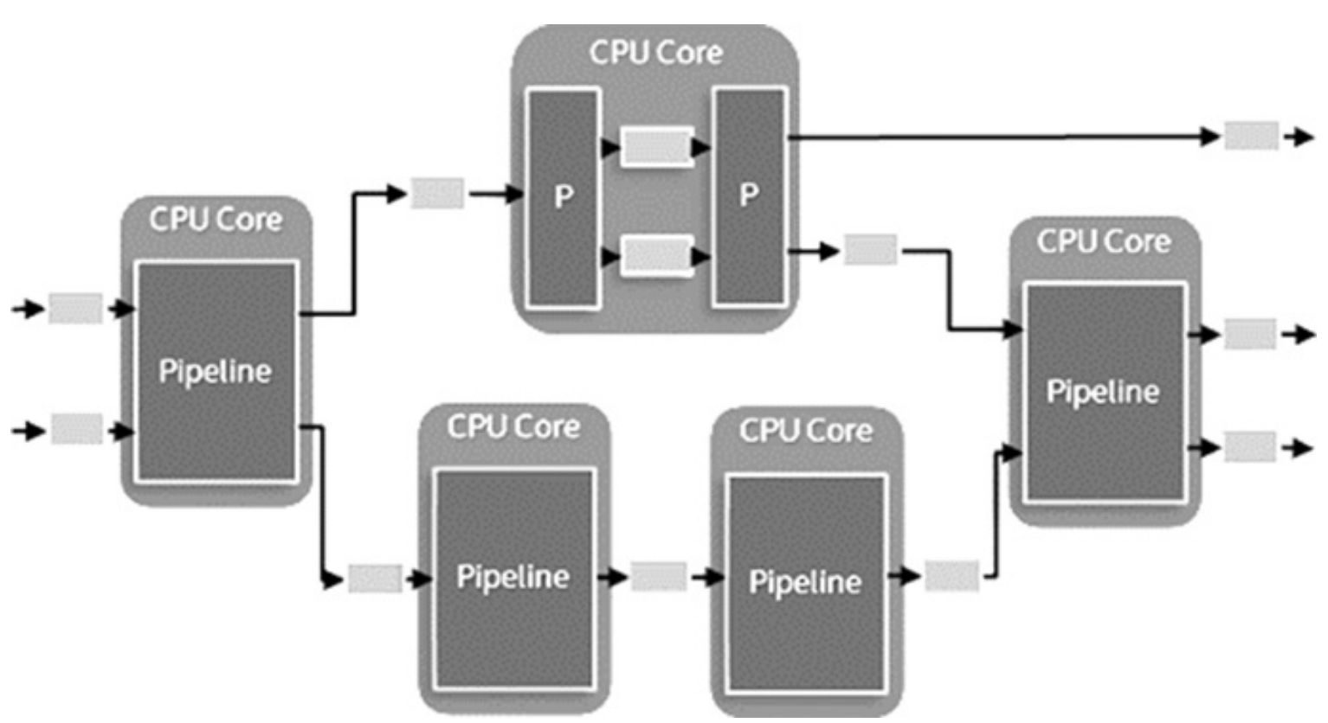
Multicore pipeline application (e.g. hybrid)

Slide 54
Librte_port
Implements different types of packet port and defines initialization and runtime of ports
Port type | desc
SW Ring | A software circular buffer for packet/message transfer between pipeline modules
HW Ring | Queue of buffer descriptors used to interact with NIC, switch, or accelerator ports
IP Reassembly | Assembles IP fragments to an IP datagram.
Kernel NIC Interface (KNI) Port | Interface for sending/receiving packets to/from Linux kernel space.
Sink Port | Packet terminator port to drop all input packets, similar to Linux kernel /dev/null character device.

Slide 55
Librte_table
Different type of table lookups
Exact match algorithm
Hash Table: used to implement flow classification , ARP tables
Hash Library
Elastic Flow Distributer
Wildcard match algorithms:
LPM: usually used to implement L3 routing
ACL: used for firewalls
Array Table: The lookup key is a table entry index and is used for small databases

Slide 56
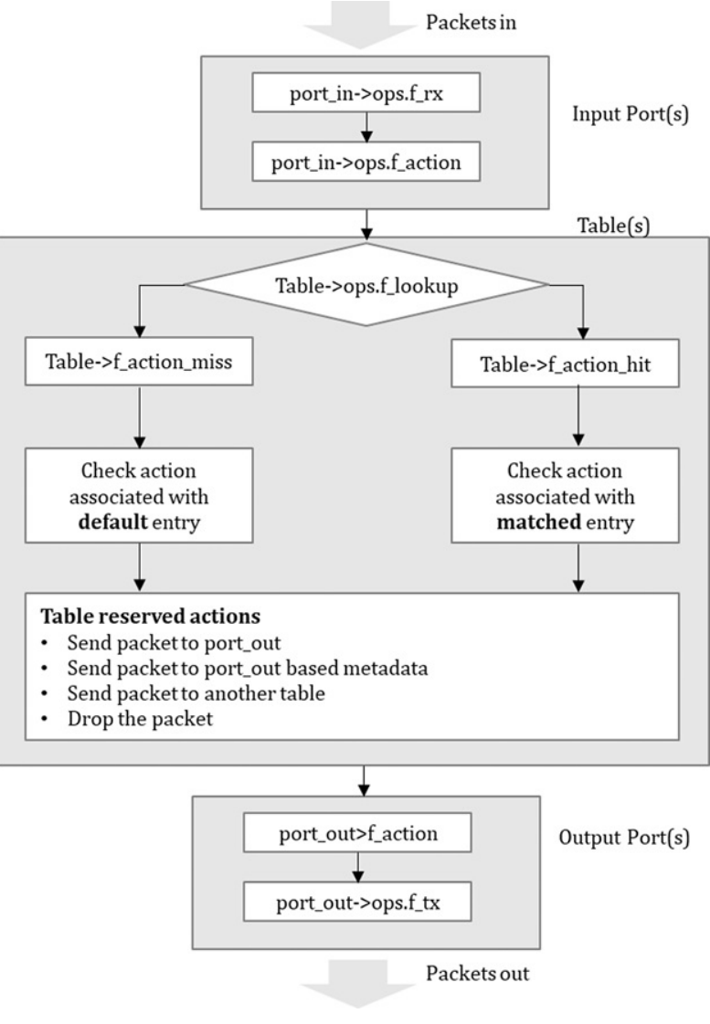
Librte_pipeline
After librte_port and librte_table modules created, it configures and connect them
The pipeline tables can be updated during runtime, and the input ports can be disabled or enabled later on as required.

Slide 57
Event Scheduling
How packets scheduled from I/O to core, core to core, core to device.
DPDK event/packet scheduling approaches
NIC based packet scheduler
RSS
FDir
Software based packet scheduler
Event device framework
event dev programming model
Simplifies packet processing with automatic multi core scaling, dynamic load balancing, pipelining, packet ingress order maintenance, synchronization service
Core polls the scheduler to select a packet
eventdev composed of port, queue, schedule

Slide 58
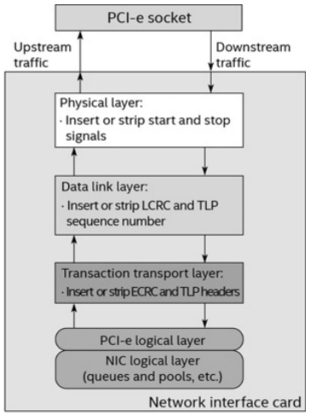
PCIe based NIC
PCIe Interface NICs are supported by DPDK
There is transactions overhead for TLP headers when CPU receives/sends packets from/to NIC especially for smaller packets
Newer PCIe gens reduces the overhead and also increases the number of lanes per slot but should be supported by CPU

Slide 59
NIC descriptor
Ring-based Queue is a circular buffer in RAM and consists of packet buffer descriptor and is used by NIC to interact with CPU or software
Each packet has a memory buffer + associated packet buffer descriptor
Ring Queue registers:
Base: start address of allocate memory by CPU
Size: number of all buffer descriptors
Head: descriptor that is currently in use. Not writeable by software only by NIC
Tail: owned by software driver

Slide 60
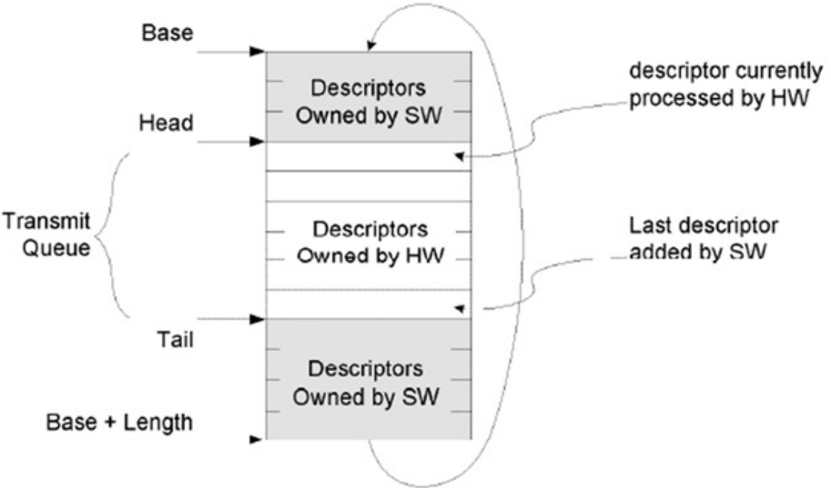
Intel® 82599’s descriptor

Slide 61
NIC Driver
Driver responsibilities:
Set packet mbuf address into packet descriptor and then NIC can use it for DMA.
Updating Tail register so the NIC will know the free space for packet descriptors.
Check DD (a flag bit in buffer descriptor):
When packet is RX: refill the buffer memory
When packet is TX: realizing the memory buffer
Configure packet mbuf of packet descriptor
Process the buffer descriptor
Handle RSS, NIC offload

Slide 62
Packet RX
The CPU fills the packet buffer address into the RX descriptor : memory read
The NIC reads the RX descriptor (rxd) to obtain the memory address : PCIe downstream
The NIC writes the packet to the specified memory address (DMA) : PCIe upstream
The NIC updates the RX descriptor to notify the RX completion : PCIe upstream
The CPU reads the RX descriptor and completes the packet RX : memory read
The CPU processes the packet and decides the next step (processing) : memory read
The CPU may change the packet and send it memory read : memory read

Slide 63
Packet TX
The CPU reads the TX descriptor to check if any packet is sent successfully : memory read
The CPU writes the packet buffer address to the next TX descriptor : memory write
The NIC reads the TX descriptor to get the packet memory : PCIe downstream
The NIC reads the packet data from the address : PCIe downstream
The NIC updates the TX descriptor after packet TX is completed : PCIe upstream

Slide 64
RX/TX Optimization
Reduce MMIO access
For packet RX, DPDK will use a RX buffer threshold
Improve PCIe data transfer efficiency
Merge multiple descriptor access
On TX, NIC can writes status bit of packet descriptor for multiple packets (bulk packet transmit)
Avoid partial writes of cache line (especially when DMA is writing packet to memory)
Make sure all packet buffer addresses are cache lined

Slide 65
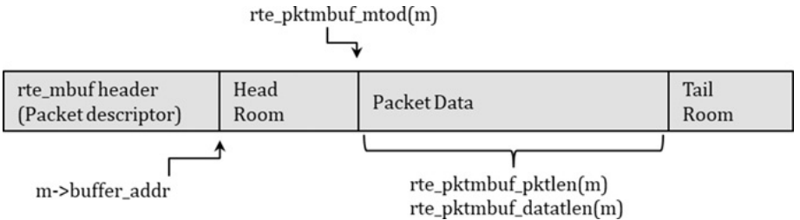
Memory
mbuf
All mbufs are cache aligned but their size is configurable
Packet data and packet descriptor can be placed in the same memory region
For jumbo frames (>9KB), there can be mbuf chaining.
mempool:
It will reserved at DPDK initialization and returning mbuf from it to PMD, is not related to OS!
It is also ring based

Slide 66
PMD
A new NIC driver
In NIC interrupt mode there is a CPU overhead for context switching
PMD is responsible for NIC port/queue initialization and setup (filling mbuf elements to HW descriptor and informing NIC to place packet to that area).
In packet RX after DD bit of HW descriptor enabled, the software will update buffer descriptor with HW descriptor (which is a part of packet mbuf). After that a new buffer descriptor will be allocated to this NIC HW descriptor for receiving new packet.
In packet TX, PMD will read the mbuf and uses packet buffer descriptor to setup the NIC TX (hw) descriptor
HW descriptor is specific to each NIC, and buffer descriptor is general interface in DPDK
Hybrid Mode (l3fwd-power): depends on interrupt generated by UIO or VFIO
l3fwd-power
Notes:
In Hybrid mode (HIP), the core is by default in busy mode until it surpass the threshold.

Slide 67
Packet RX/TX performance optimization
Packet burst: reduces less memory access( or low-level cache) for burst of packets
rte_eth_rx_burst(port_id,queue_id,mbuf_pkts,nb_pkts);
Batch processing:
reducing instruction latency
using CPU out-of-order execution and increasing concurrency
Just break the operation into multiple task
SIMD

Slide 68
Platform Configuration
Hardware tunning
Processor:
Utilizing improved instructions of newer CPUs (AVX instruction set)
Increasing cache line
Memory
NIC: extended tag
Software tunning: Linux kernel, huge page size, core pinning, compilation flags, RSS config (NIC tunning)➔
RX/TX queue length:
RX/TX queue threshold: descriptor threshold to update tail ring and it will reduce MMIO

Slide 69
NIC offload : NIC-Based Parallelism
Use cases:
Load balancing
Application specific steering
Fdir
RSS
Hybrid

Slide 70
RTE_FLOW
Since DPDK 17.02 for flow based configuration on PMDs (not a specific NIC or FPGA)
Create flow rules for a NIC:
Command line
Source code

Slide 71
More NIC offload
NIC will write the (header) parsing result into buffer descriptor of packet
Offload flags:
Offload feature of NIC are configurable on a port basis
Each packet buffer has 64-bits for offload flags (ol_flags) and are readen or written by DPDK to guide NIC on how to handle each packet
The DPDK must have the API, so then we can enable it on port
Features can be port/queue level (coarse grained) or packet level (fine grained)
First query the capabilities/ configurations (via testpmd or source code) and then use them

Slide 72
NIC common offload features
Header parsing: computation and update
VLAN offload (filtering + stripping + interstation)
IEEE1588 offload (Precision Time Protocol) for time synchronization
Checksum offload
Tunnel offload (VXLAN and NVGRE)
Segmentation offload on TX side (TSO)
Segmentation: splitting a large packet into multiple small packets at the TX side

Slide 73
Packet Security
Regardless of a specific security protocol (SSL,IPSEC,..), security processing ( encryption, authentication, compressing) has the following key aspects:
Data Confidentiality
Data Integrity
Secret key exchange

Slide 74
History
Software Based Encryption: general-purpose CPUs such as Intel® Pentium Pro processor, the encryption of AES takes 18 cycles per byte, equivalent to 0.144 ms per block, or 11 MB/s for a 200-MHz processor
Intel® AES – NI (AES New Instructions)
It can be used with SIMD (for repeated parts of encryption and multi-buffer for dependent parts)
Intel® published the open-source multi-buffer IPsec library. It supports multiple symmetric algorithms implemented by Intel® SIMD intrinsic and multibuffered technology, and this library has been integrated with the DPDK Cryptodev library. This software is CPU-based implementation, and it can be used without DPDK
Intel Quick Assist Technology:
a special PCIe device driver and accelerator. DPDK crypto dev also supports it.
DPDK cryptodev

Slide 75
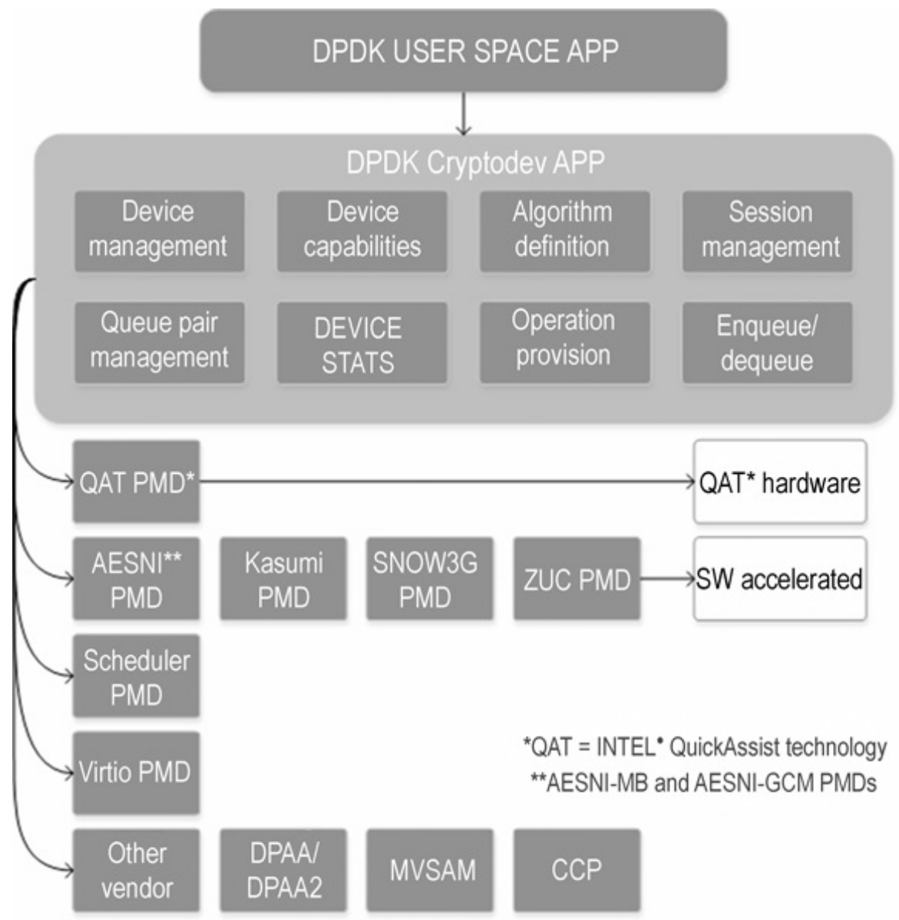
Cryptodev
Multivendor driver integration
The Cryptodev goal is to design the software abstraction layer, and it works with software (CPU)- or hardware-accelerated crypto-devices
The operation is asynchronous (enqueue and dequeue pairs)
APIs:
Device Management: queue pairs (enq/deq) and NUMA awareness
Queue pair management: allocation and initialization used by user
Device capabilities: report capability
Session Management: common and device-specific data area for temporary keys, initial vector and AAD lengths, etc.
Enqueue/Dequeue: burst based
Synchronous CPU crypto processing for different software crypto drivers

Slide 76
Cryptodev PMD
Multiple vendors implemented Cryptodev PMD in DPDK (for example Intel QAT PMD)
Considerations before using Cryptodev:
Device Capabilities: query the PMD to see the specific methods that are implemented
rte_cryptodev_ops: a data structure contains a set of callback function pointers and can help the user application to config device, queue pairs and sessions to get and clear the statistics
Enqueue/dequeue callback functions are two main datapath operation of cryptodev
Also these should be provided by PMD during device creation: rte_cryptodev structure, flags, …

Slide 77
Example
simple cryptographic application using the symmetric AES-CBC cipher algorithm and SHA1 hash algorithm to encrypt and authenticate the packets step-by-step (we use DH895XCC QAT):
Step 1 – Cryptodev assignment:
Release the linux kernel driver and assign QAT to DPDK
./dpdk/usertools/dpdk-devbind.py -s 0000:88:00.0 'DH895XCC Series QAT 0435' if= drv=dh895xcc unused=qat_dh895xcc
Configure the number of VFs to QAT device (Different device will support different max VFs):
echo 2 > /sys/bus/pci/drivers/dh895xcc/0000\:88\:00.0/sriov_numvfs
Expose crypto dev to target application (here l2fwd-crypto)
./l2fwd-crypto -l 11-n 4--socket-mem 0,2048 -w 88:01.0- w 88:01.1 -w 84:00.0–

Slide 78
Example – part 2
Step 2 – Cryptodev configuration:
Queue pair (enqueue/ dequeue) setup
Step 3 – Session configuration:
By using sessions, we can store key or data that can be used by multiple cryptodev operations (or PMDs)
int rte_cryptodev_sym_session_init(uint8_t dev_id, struct rte_cryptodev_sym_session *sess, struct rte_crypto_sym_xform *xforms, struct rte_mempool *mempool);
Step 4 – Assemble Crypto Ops:
The mbuf are wrapped with an extra mbuf called rte_crypto_op plus one asymmetric (rte_crypto_asym_op) or symmetric operation structure (rte_crypto_asym_op) next to it.

Slide 79
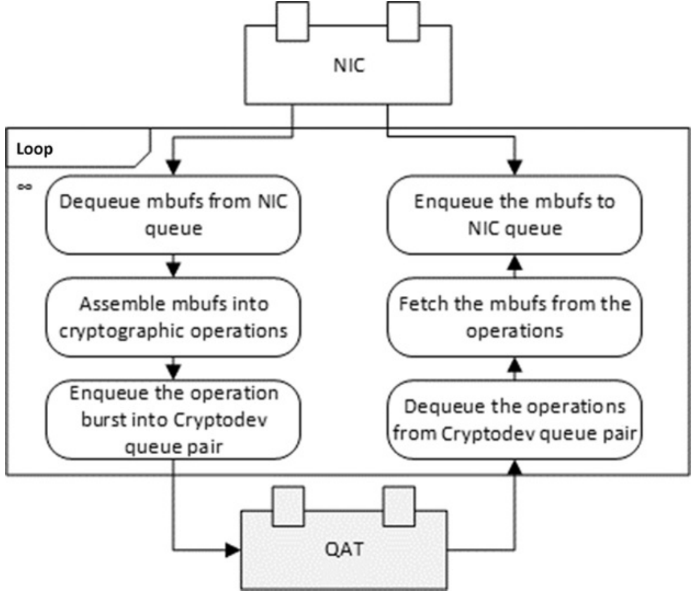
Datapath workflow of cryptodev

Slide 80
DPDK security library
Generality of cryptodev APIs may bring overhead among some PMDs
Aims to accelerate security protocol processing that works in in-line or synchronous mode
defines the generic APIs to create and destroy the security sessions, it supports the datapath packets is fully or partially offloaded to in-line crypto- to hardware based devices

Slide 81
IPSec library
In terms of IPsec datapath workload, crypto is only part of the job. The IPsec gateway application still needs to identify the flows and lookup the associated SA (Security Association), encap/decap tunnel headers, and route the packets to the specific ports
The easier way is this library

Slide 82
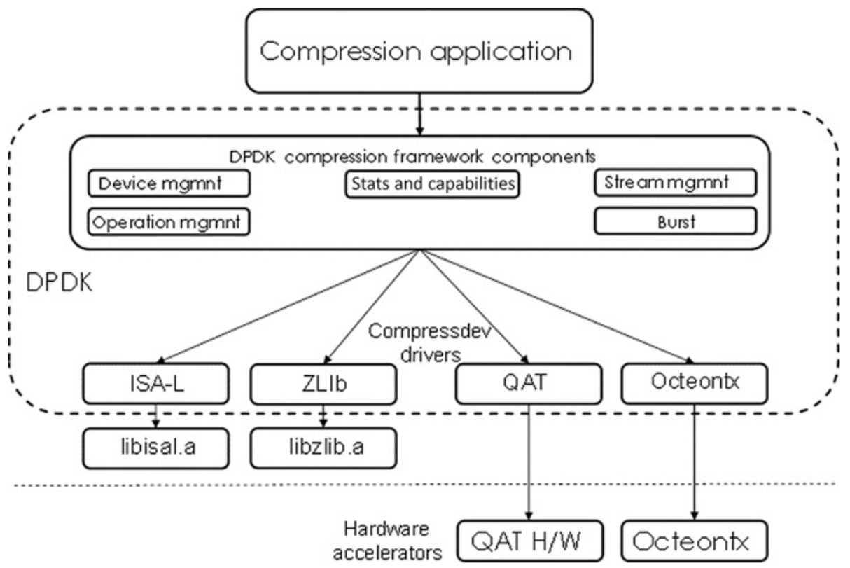
Network Compression
DPDK compressdev provides a DPDK Compress Device Library and a number of compression PMDs for software/hardware compression accelerations

Slide 83
I/O Virtualization
Hardware Virtualization
Virtio
Vhost-user

Slide 84
Cloud Era
Cloud providers are emerging as XaaS
Multiple workload can be managed on a single host by Virtualization on physical resources
Virtualization
software abstract layer and has no dependency on hardware and provides more util of resources
Elastic server model
Different Hypervisor (VMM) virtual IO interface for highspeed:
virtio-pmd ➔ KVM
vmxnet3-pmd ➔ VMWare
netvsc-pmd ➔ Hyper-V
Physical resources that can be virtualized on a server platform: CPU, Memory, I/O

Slide 85
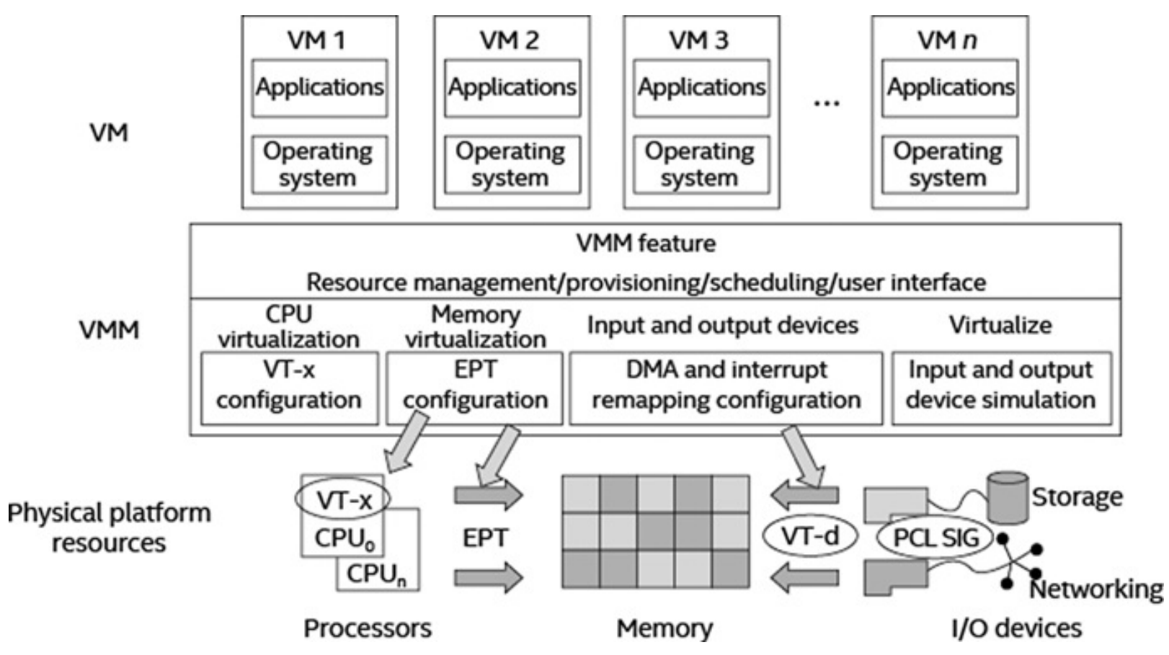
X86 Virtualization
X86 Virtualization emerged as arrival of multicores
Intel X86 provides hardware assisted virtualization technology such as VT-x, VT-d

Slide 86
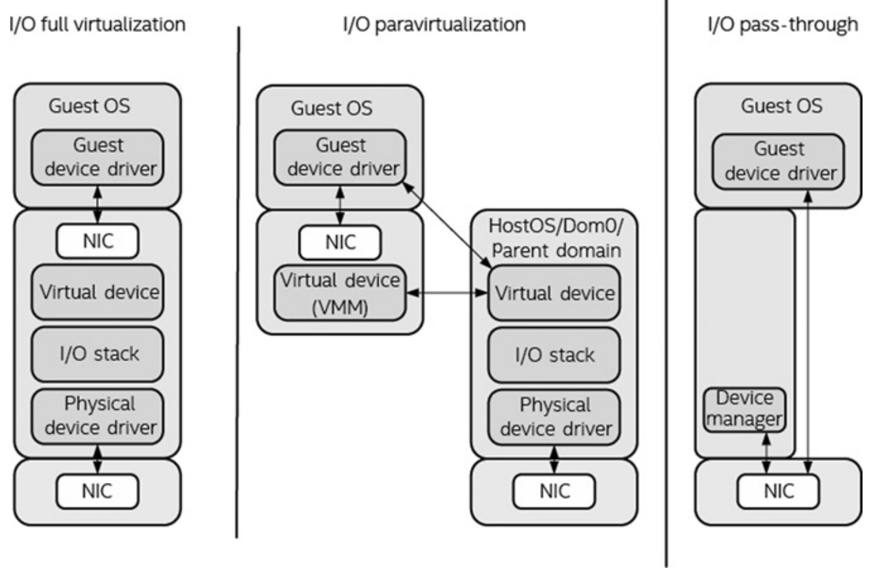
VT-X
CPU Virtualization process execution:
VMX-root: hypervisor
VMX non-root: guests
Memory Virtualization: provides new virtual address Space by two level-address translation address Space
The hardware complexity is reduced by software EPT implementation
Guest Virtual Address (GVA)
Guest Physical Address (GPA)
Host Physical Address (HPA)
EMT : GVA→GPA
I/O Virtualization models:
Full
Paravirtualization
Pass-through

Slide 87
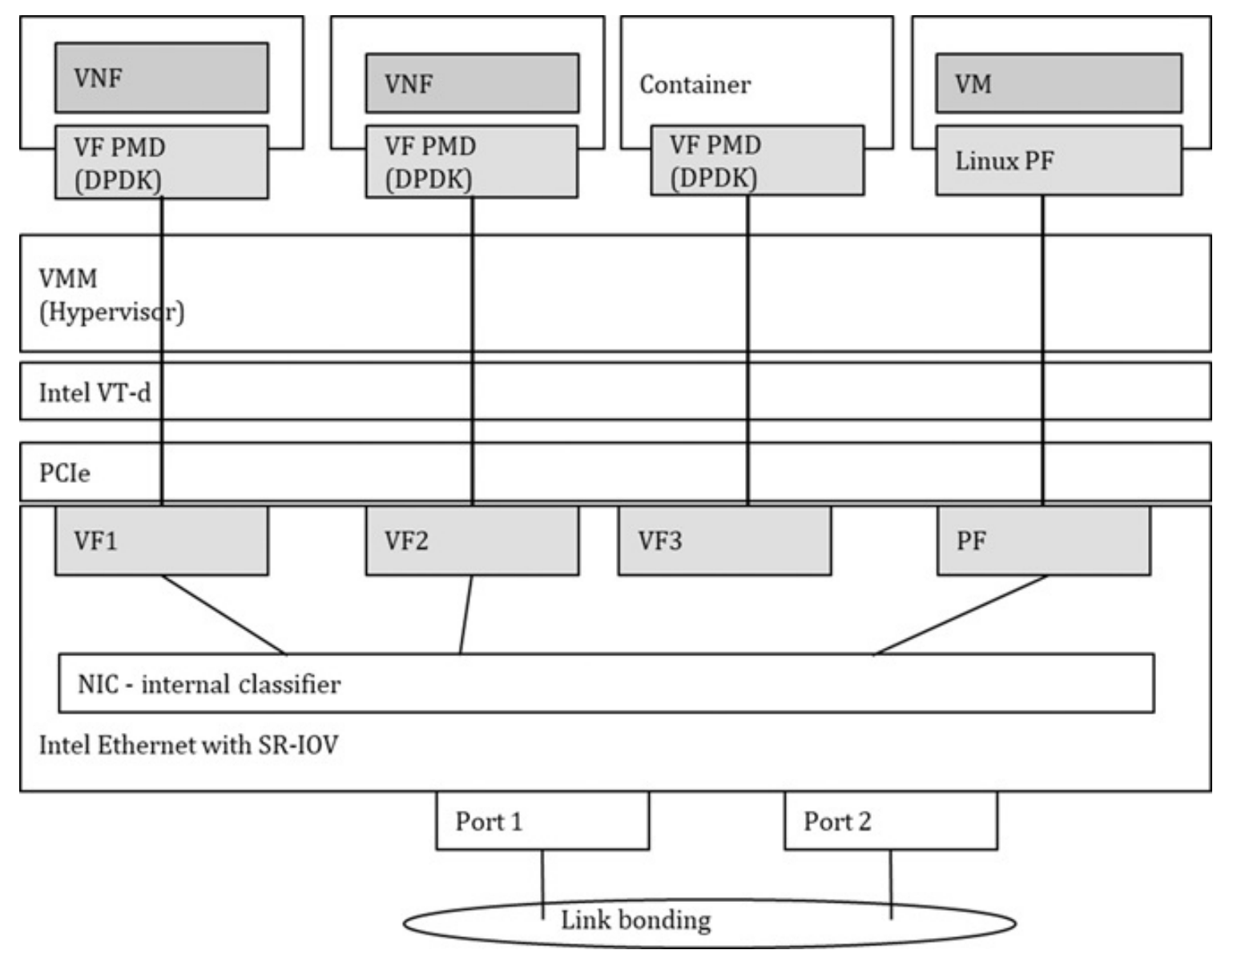
I/O passthrough
Most PCI/e devices are Intel VT-d ready
Challenges:
X86 platform supports limited number of PCIe devices
Live migration

Slide 88
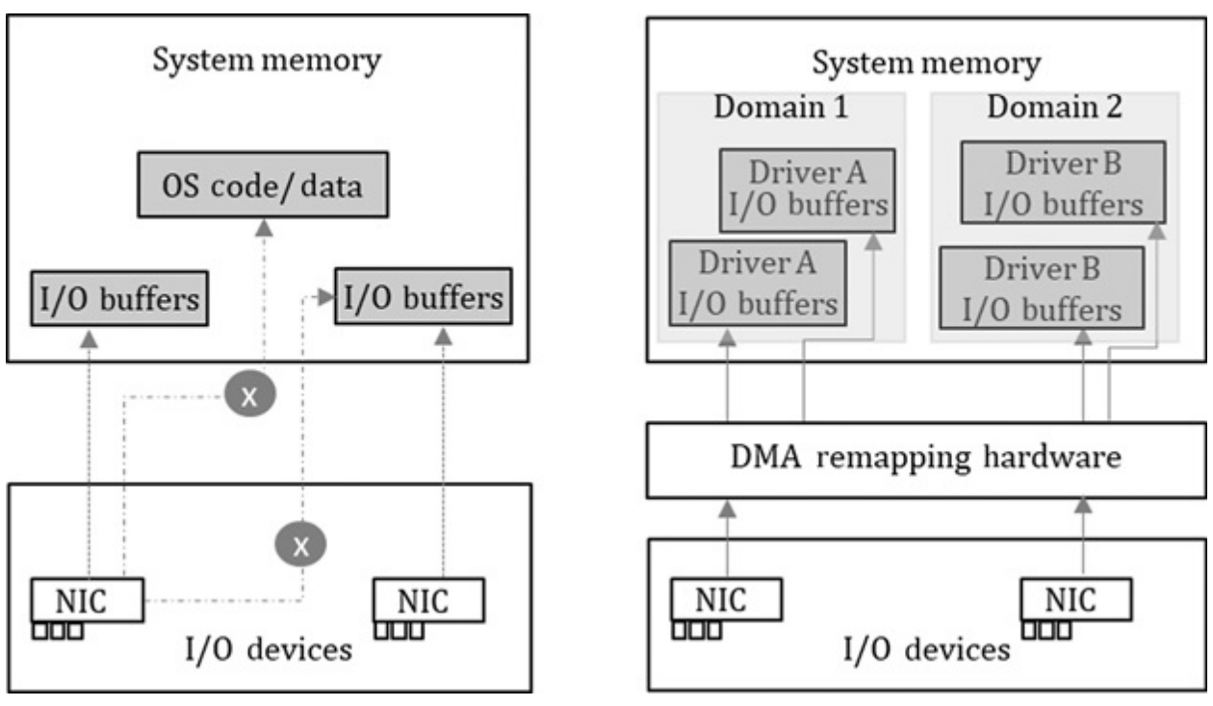
Intel VT-d
Address translation through the DMA remapping functions and direct device assignment
Produced protected domain

Slide 89
SR-IOV
PCIe pass-through mechanism allows a NIC to be passed to a VM directly
Supports 256 functions means that we can share NIC among VM through the definition of PF and VF concepts
PF (Physical Function): a PCIe function with SR-IOV extended capability. It is responsible for configuring the device. In theory, a device can support multiple PFs. Today, most NICs only support one PF, and PF cannot be dynamically created and destroyed in the system
VF (Virtual Function): a “lightweight” function and a virtual instance of partial device resource but necessary for basic function. VF can be created and destroyed by PF. Each VF has its own independent PCI configuration space, send and receive queues, interrupts, and other resources. The hypervisor can assign one or more VFs to a VM. Similarly, one or more VFs can be assigned to the container instance

Slide 90
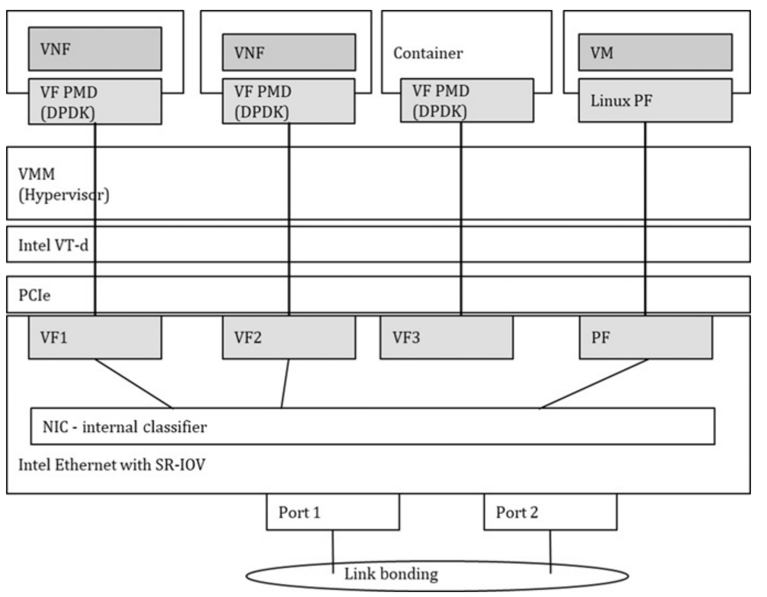
SR-IOV

Slide 91
virtio (virtio-net)
Hardware independent, vendor neutral of Live Migration
First was for QEMU and KVM. Now supported by most OS
Better than legacy emulated network IO device in hypervisor
Requires guest to install specific Virtio drivers.
DPDK introduced PMD to further improve performance
The performance is not better than Passthrough. So why we need?
Some industry players have started to implement Virtio interface in NIC (Hardware- assisted Virtio) so improving its performance
3 specific versions: 0.95 (legacy), 1.0 (modern, PCIe), 1.1

Slide 92
Device Initialization using driver
Device Status flag
Feature bits
Interrupt configuration
Interrupt modes: INT-X or MSI-X
Interrupt sources: Device interrupt source or Queue interrupt source
Device-specific configurations

Slide 93
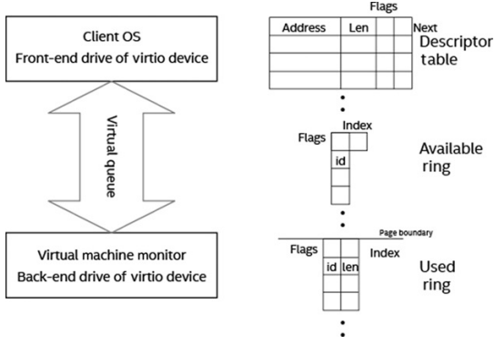
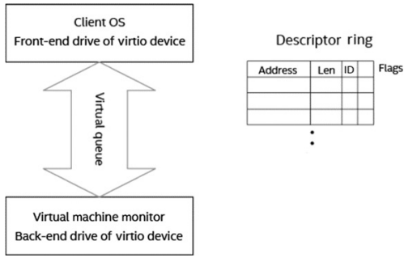
Virtqueue
Virtqueue: an interface on top of PCI that is used for communication between front-end and back-end
Split Virtqueue
Packed Virtqueue

Slide 94
Virtio-net driver
Consists of layered implementation:
PCI-e device layer
Virtqueue layer
Network device layer

Slide 95
Virtio-net-pmd driver
Same structure as Virtio-net (three layers)
Virtual-queue implementation:
virtio_ethdev.c: setup devices
virtio_rxtx.c: receiving/sending packets
Supports:
Indirect feature for packet sending: only one descriptor for sending and receiving packet
In-order feature for rings
Multi-queue support

Slide 96
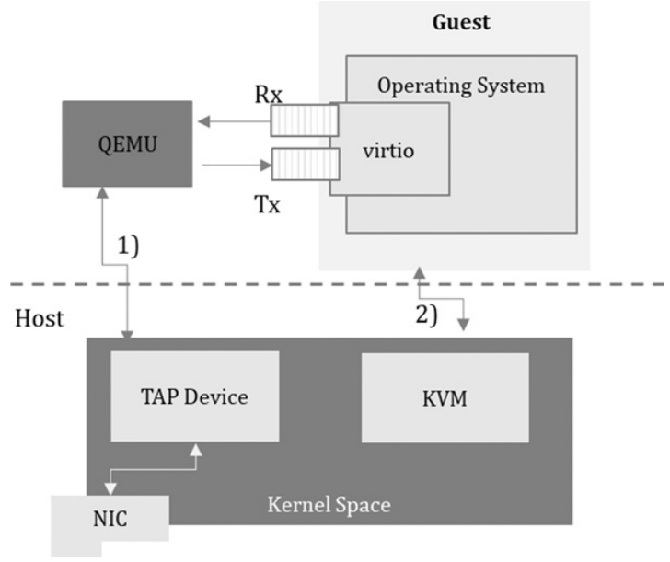
Before Vhost
QEMU overhead!
In this example, the user wants to send.
There is overhead of QEMU for both message-path (line 2) and data-path (line 1)

Slide 97
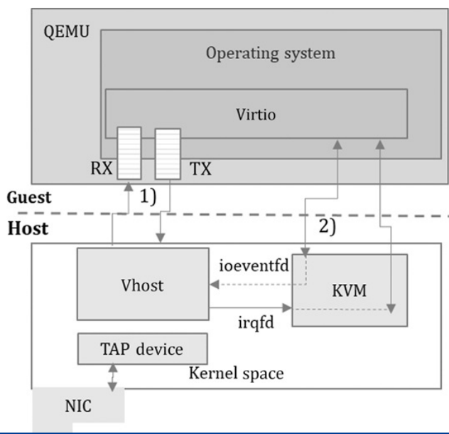
vhost-net (kernel module driver)
Reception:
Datapath: The packet received from the TAP device is copied to the area which is owned by the virtual queue through the vhost-net module
Messagepath: When the packet from the TAP device arrives at vhost-net, an interrupt is sent to the guest through the KVM module and the guest is notified

Slide 98
vhost-net
QEMU shares the guest memory layout. vhost-net is allowed to access the address translation information from GPA to HPA
QEMU shares the address of the virtual queues. vhost-net can access them for packet sending and receiving. Because the virtual queue address is the address in the virtual space of the QEMU process, it should be translated into the virtual address in the process where vhost-net resides
QEMU shares the event file descriptor (eventfd), which is configured in KVM for sending interrupts to the vhost-net device in the guest. In this way, vhost-net can notify the guest to receive the arrived packet in the receive queue
QEMU shares the eventfd which is configured in KVM, and the guest can write to vhostnet PCI configuration space. The event will be triggered when there is a guest to write to PCI configuration space on the vhost-net port. This method can notify vhost-net in the host that there is a packet to be sent.

Slide 99
vhost-user
It is in userspace and supported by DPDK
Like VHost-net, it implements virtual queues, message notifications,…
It is also able to run in PMD mode by cores
For DPDK support, the guest can run virtio-net driver (in kernel) or virtio-pmd (in userspace)
Specific Capabilities:
Virtio-net network devices management
Mapping/unmapping of descriptors, rings, … in virtual queue
Mapping/unmapping of actual packet buffer into virtual address space of vhost process
Vhost datapath acceleration (vDPA) is the latest design in implementing the vhost datapath on accelerators such as FPGA-based Smart NIC. This approach continues supporting the virtio interface, which is a proven standard interface

Slide 100
Vhost-user
Vhost users is based on socket server to process QEMU messages. If there is a new socket connection, the guest creates a new virtio-net device and the vhost-user driver will create a vhost device in the back-end to pair with
After receiving the message VHOST_SET_MEM_TABLE from QEMU, vhost maps the QEMU physical memory into its own virtual memory space by using the memory table (file descriptor, address offset, block size, and other information) in the message. The rte_vhost_mem_region data structure is used to store the region information and mapping relation of QEMU memory files. The overall region information is stored using the rte_vhost_memory data structure
When initializing the device, the guest virtio-net front-end driver will query the features supported by the vhost back-end driver

Slide 101
Virtio-net device lifecycle
Device creation:
Assign a new virtio-net device architecture and add it to virtio-net device list
Assign core for serving virtio-net and also add virtio-net device into the list on data plane.
Assign RX/TX queue for virtio-net
Configuration: maps virtual queues into its own virtual address space
Service kick-off: vhost can poll its receiving queues and put data in the receiving queue of the virtio-net device. It can also poll the virtual sending queues to check for data packets ready to be sent. If there are any, they are copied to the sending queue.
Virtio-net device destruction:
stop the polling of the transmitted virtual queues and the polling of NIC receiving queues.
realizing cores assigned to the virtio-net device and the RX/TX queues on the physical NIC.

Slide 102
vhost-pmd
static struct rte_vdev_driver pmd_vhost_drv = {
.probe = rte_pmd_vhost_probe,
.remove = rte_pmd_vhost_remove, };
After init there is no difference compared to physical NICs
Multi-queues can be enabled in vhost-PMD with devargs “queues=“

Slide 103
DPDK Application
DPDK for NFV
Virtual Switch
Storage Acceleration

Slide 104
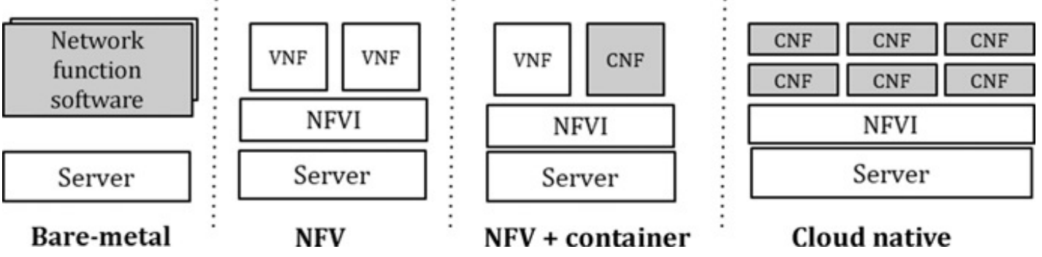
1- Network Functions

Slide 105
NFV
Today cloud providers produce network appliances virtual routers, switches, firewalls,..
VNF is virtual network function running within VM
CNF is virtual network function running in a container
NFVI is request-based. No need to reserve beforehand
DPDK is used in NFVI and VNF
The packet delivery from server to VNF can be done in two ways:
By NIC: SOR-IV
By Vswitch(virtual switch): virtio-pmd as the virtualized interface for VNF and DPDK-accelerated vswitch (OVS-DPDK)

Slide 106
VNF
VNF is a software module placed on a NFVI-capable server system
VNF placement consideration:
System Resource Allocation: CPU (cores), RAM, Storage,…
Virtualized Interface: physical NICs are shared resources. VNF instance can choose:
Software interface : Virtio,…
SRIOV/VF or interface passthrough of PCIe device
NIC driver: default is kernel module but it can be partitioned with SRIOV, DPDK-PMD is another choice
Hardware Acceleration: These are hardware dependent platforms to speed up. E.g.: Smart NICs, FPGAs,…
QOS: Intel RDT technology to control shared resources usage and detect noisy neighbors

Slide 107
Opensource NFV
Different cloud providers with different capabilities (Amazon’s ixgb and ENA interface,…)
Opensource projects:
FD.IO/VPP:
A Vector Packet Processing running in user space
based on DPDK
can be used for non-virtualized or virtualized environments.
Process multiple packets on the same time using graph nodes
Graph node is customizable for different packet processing path
Snort:
DPDK is used in Data Acquisition Model packet interface(DAQ)
Intel “HyperScan” can also be integrated

Slide 108
2- Virtual Switch
Networking for NFVs in the cloud
Datapathes:
East-west: between VNF’s VMs in the same host
North-south: between VNF’s VM and external functions that can be across multiple servers
Available Virtual Switches: all of them use DPDK
Open-Source: OVS, VPP, Snabb, Lagopus, VPP, Tungsten Fabric, …
Commercial: VMWare NSX-T, Juniper Contail, Wind River Titanium Edition, 6WINDGate…

Slide 109
Open vSwitch - OVS
ofctl
appctl
vsctl
monitor
setting
config
User
openflow
configs
vswitchd
config
db-server
runtime statics
openvswitch.ko
Kernel

Slide 110
OVS datapath - Kernel (Native) Datapath
Flow rules which have been configured in the user space through the tools and components mentioned in the previous sections are represented in the kernel in a simple flow table
Rule
Upcall – Exception Packet
vswitchd
Flow table
Netlink
NIC
Kernel
User
packet

Slide 111
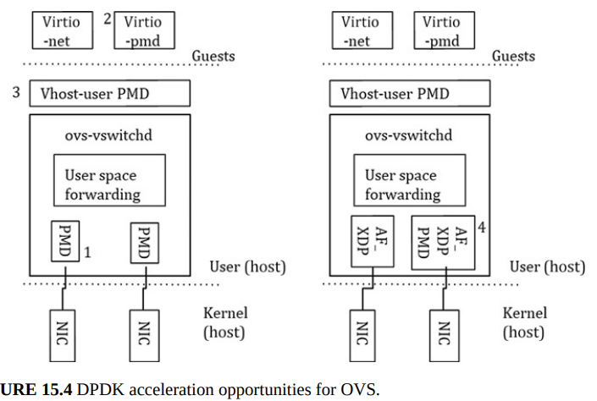
UserSpace Datapath and DPDK/PMD acceleration
moves the forwarding plane into user space
It possible to leverage DPDK’s user space libraries and drivers for accelerated packet processing and IO

Slide 112
3- Storage Acceleration
Write Scenario ➔ two data copies:
Network data write from kernel to userspace ➔ solution: ZeroCopy
Backend storage drive to write data on device
Applications
User mode
2
3
Kernel
Kernel mode
1
4
NIC
Storage driver

Slide 113
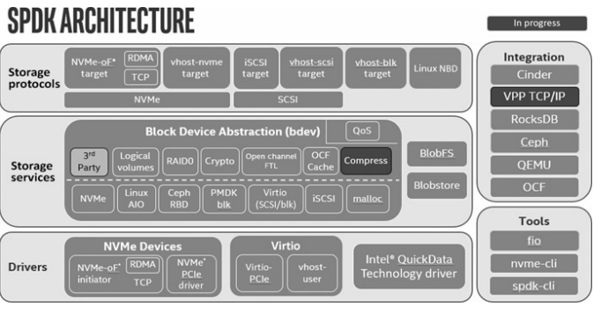
SPDK
A collection of open source software libraries for high performance storage workload
Adopts lots of DPDK optimization ideas and also includes the PMDs for NVMe SSD. It also has some other libraries to mange CPU,… and other resources use by storage workload

Slide 114
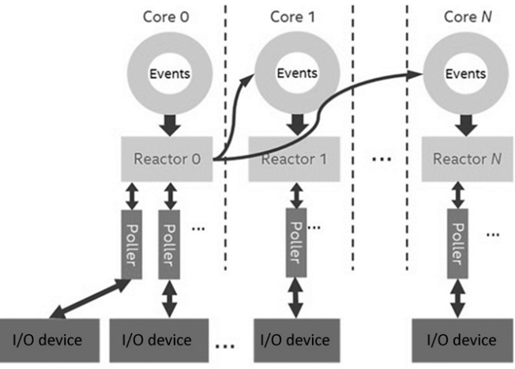
SPDK Event Framework

Slide 115
Storage PMD
Move storage device driver to user space
Removes huge systemcalls() and also eliminates data copy from kernel to user
Async I/O mode: application requests the I/O, and a further function check is followed for I/O completion.
Lockfree design: SPDK adopts a lockless design, and each core (thread) accesses its own resources such as memory, I/O submission queue, I/O completion queue.

Slide 116
Storage Services
Abstraction layer from block IO interface to application
Blobstore: persistent, power-fail-safe block allocator designed to support a high-level storage service such as key/value stores (e.g., RocksDB) or local databases (MySQL), dedicated appliances (SAN and NAS), distributed storage systems (e.g., Cassandra)
‌BDEV: NVMe device abstraction and other libraries to export the block service interface to applications

Slide 117
Storage Protocols
SPDK can be used in 3 scenarios:
Back-end storage applications with block devices such as iSCSI, NVMe
VM acceleration: If QEMU/KVM is used as a hypervisor, the vhost protocol implements an efficient vhost user space target based on a shared memory channel (for example, vhost SCSI/blk/NVMe target) to speed up the I/O while using the virtio SCSI/blk and kernel-native NVMe protocols in the virtual machine. It reduces the number of events such as VM interrupts and shortens the I/O stack in the host
Database storage engine acceleration: for example RocksDB. SPDK’s blobfs/blobstore can now be integrated to speed up the RocksDB engine to access NVMe SSD.

Slide 118
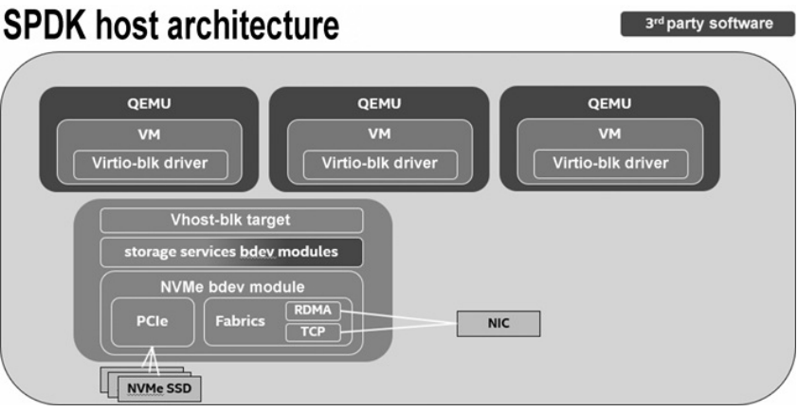
SPDK Virtualization
SPDK provides virtualization interface for when storage workload runs within VM.
VM can use virtio-blk interface to talk with the vhost-user-blk in backend(host). (no need to know underlying module)

Slide 119
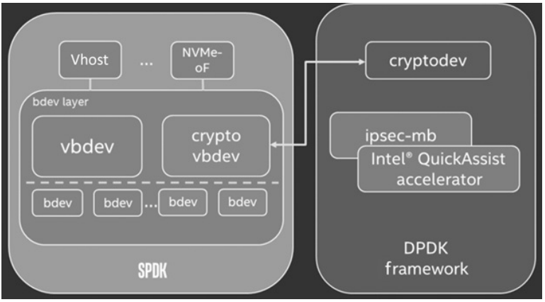
Data Security
CPU based
SPDK released cryptovbdev interface on top of DPDK cryptodev
It can also use Intel CPU QAT accelerator for PCIe device.
Disk Based Encryption
SSD/SED/Opal vbdev

Slide 120
DPDK in Action
Each application can have a shared memory via hugepages with custom privileges.
Multi-process support:
Primary instance: able to define shared memory with highest privileges
Secondary instance: can just use shared memory initialized in the previous time
Remapping memory for second process is not guaranteed to work well.
Example: rte_distributor example

